Slide 1
Scotland’s Dynamic Coast:
The National Coastal
Change Assessment
James Fitton (UofG)
Jim Hansom (UofG)
Alistair Rennie (SNH)

Slide 2
Presentation Outline
Introduction to Scottish Coast
Why is understanding coastal change important in Scotland?
What is the NCCA
Methods
Results and Outcomes
Conclusions

Slide 3
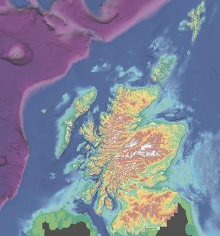
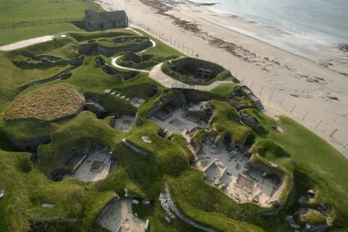
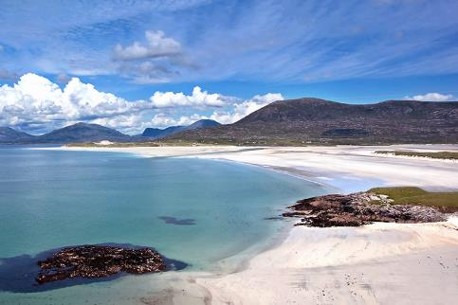
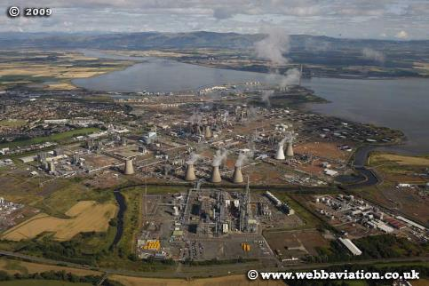
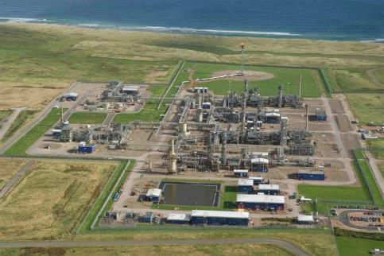
Scottish coastal assets
Population
20% of the Scottish population live within 1km of the coast (1 million)
~12 % of European coast (Pranzini and Williams 2013)
Highly variable: resilience & assets

Slide 4
Paradox of Coastal Erosion in Scotland
Many organizations have an obligation to incorporate coastal erosion within their statutory advice. Yet there is no centralized national dataset on coastal erosion – no single organization has responsibility.
Part of this is due to the devolved nature of erosion, where it is the responsibility of the landowner. The LA only gets involved when it leads to flooding. This means the LA may be aware of issues, but there is no national oversight.
Any organization will struggle to objectively appraise the risk coastal erosion poses to it’s own interests, let alone collaborate with others.

Slide 5
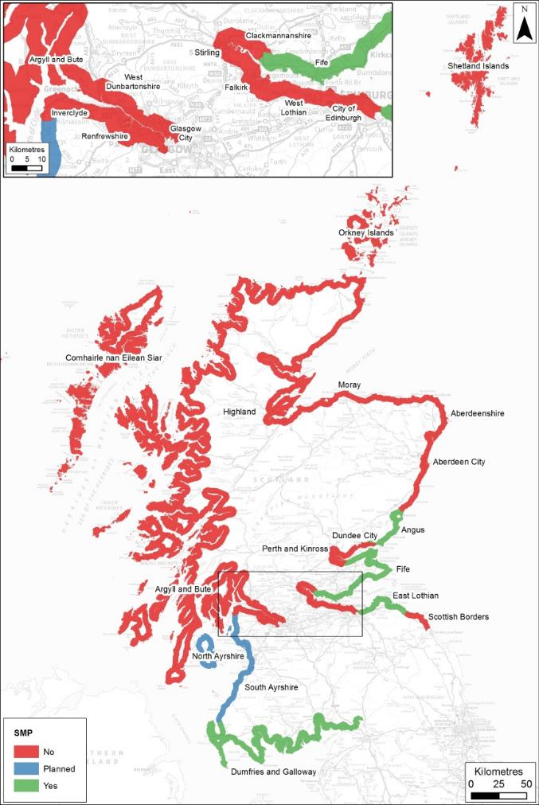
Current Data on Erosion
UK CCRA (2012) noted this as an evidence gap in Scotland:
‘Maps of past erosion, current state and future erosion conditions are required.’
Defra (2012) UKCCRA for Scotland - Final Report. p191

Slide 6
What’s coastal erosion got to do with flooding?
Why is erosion important?
Sea levels are rising across Scotland and this is already leading to increased flood occurrences. e.g. Aberdeen, Millport and Stornoway. Ball T, Werrity A, Duck RW, Edwards A, Booth L & Black AR. (2008)
Coastal flood risk in Scotland is expected to grow most rapidly in the coming decades. Estimated increase in total properties at risk for a 10% AP flood:
And this excludes erosion exacerbated flooding. SG & JBA (2014)

Slide 7
National Coastal Change Assessment (NCCA)
A major policy-driven pan-government research project collating data and information on historic and future coastal change.
NCCA has/will:
Undertake a quality assessment on existing data
Establish the past changes along Scotland's coastline
Extrapolate the historic change into the future
Undertake an initial assessment of societies' interests within these areas (road, railways, houses etc.)
Review national and regional coastal policies
Enable Strategic Planning

Slide 8
Who is involved?
50+ organisations are involved in the development of the project, and will also have access to the outputs.
Funded by
Scotland’s centre of expertise for waters

Slide 9
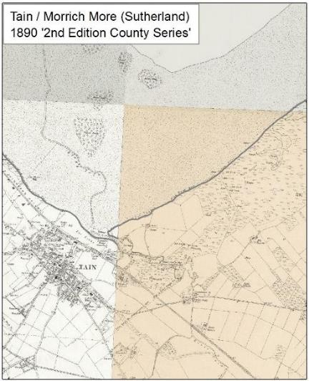
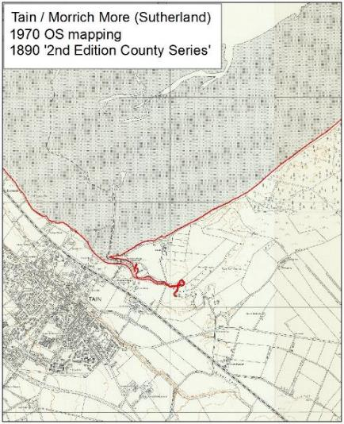
NCCA Methods
Historical change analysis is similar to SMPs
1890’s
OS Second Edition Country Series Maps
1970’s
OS 1:10,000

Slide 10
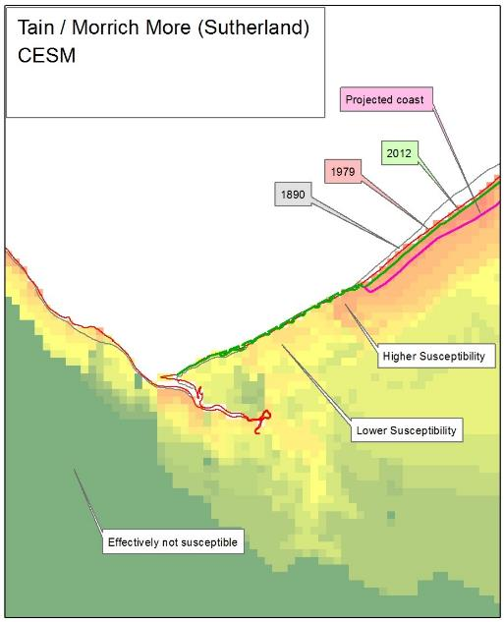
NCCA Methods
Historic Change Analysis
1890s
1970s
Current MHWS (derived from LiDAR/Aerial Photography)
Where we don’t have this data we use the OS MasterMap data*

Slide 11
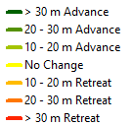
Fife – 1890s to 1970s

Slide 12
Fife – 1970s to Modern

Slide 13
Fife Statistics
1890s to 1970s
1970s to 2010s
Fife Character | Length (km) | Length (%)
Hard & Mixed | 74.1 | 33.9
Artificial | 88.8 | 40.7
Soft | 55.5 | 25.4
Total | 218.4 | 100
Fife Character | Length (km) | Length (%)
Hard & Mixed | 77.2 | 34.1
Artificial | 87.4 | 38.6
Soft | 61.8 | 27.3
Total | 226.4 | 100
%
%
Max Soft Advance (m) | 537 | North Tentsmuir
Average Soft Change (m) | 25
Max Soft Retreat (m) | 556 | South Tentsmuir
Max Soft Advance (m) | 386 | North Tentsmuir
Average Soft Change (m) | 21
Max Soft Retreat (m) | 196 | North Tentsmuir

Slide 14
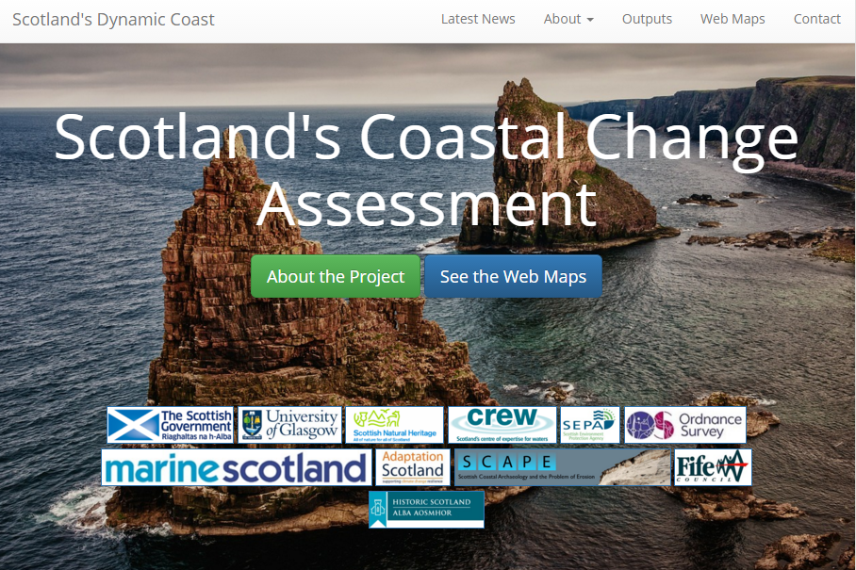
Interim results available online…
What has been done?
www.dynamiccoast.com

Slide 15
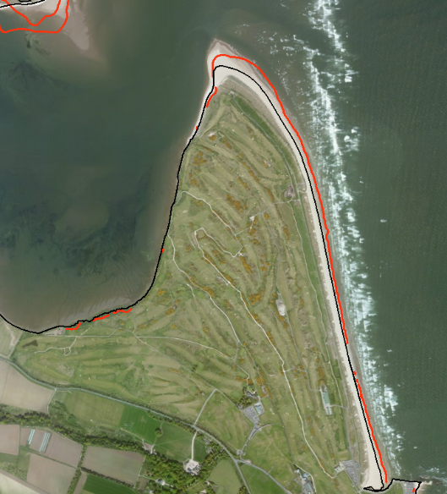
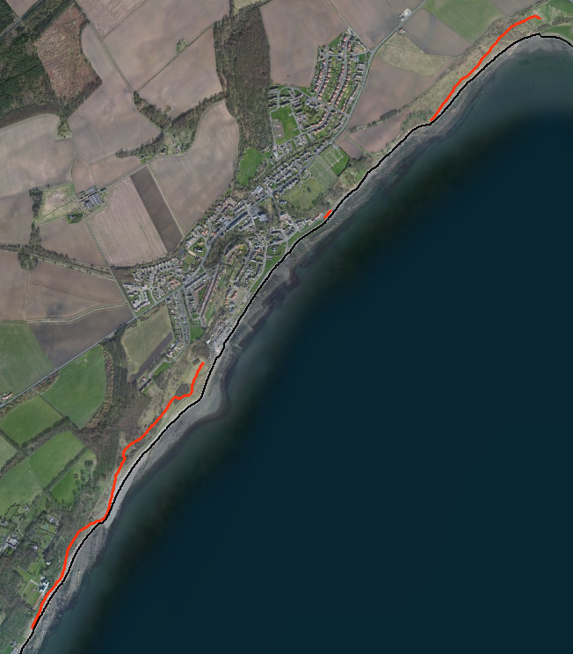
The future coast?
Past change → future coast
Future coast: 25 years (i.e. 25 x past rate)
East Wemyss
Future coast will be
amended by CESM.
St Andrews & Eden Estuary

Slide 16
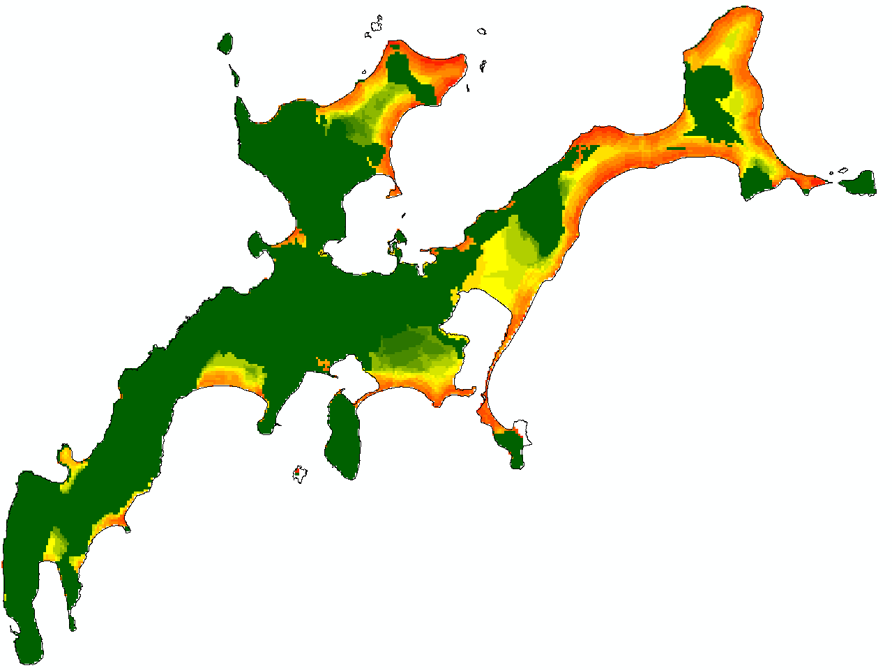
Coastal Erosion Susceptibility Model (CESM)
High: 100
Low:0
5 km

Slide 17
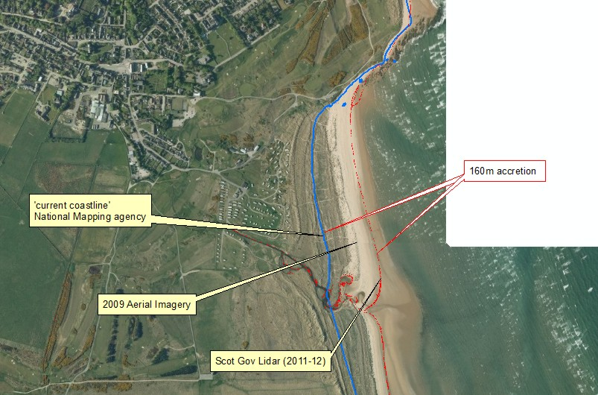

Slide 18
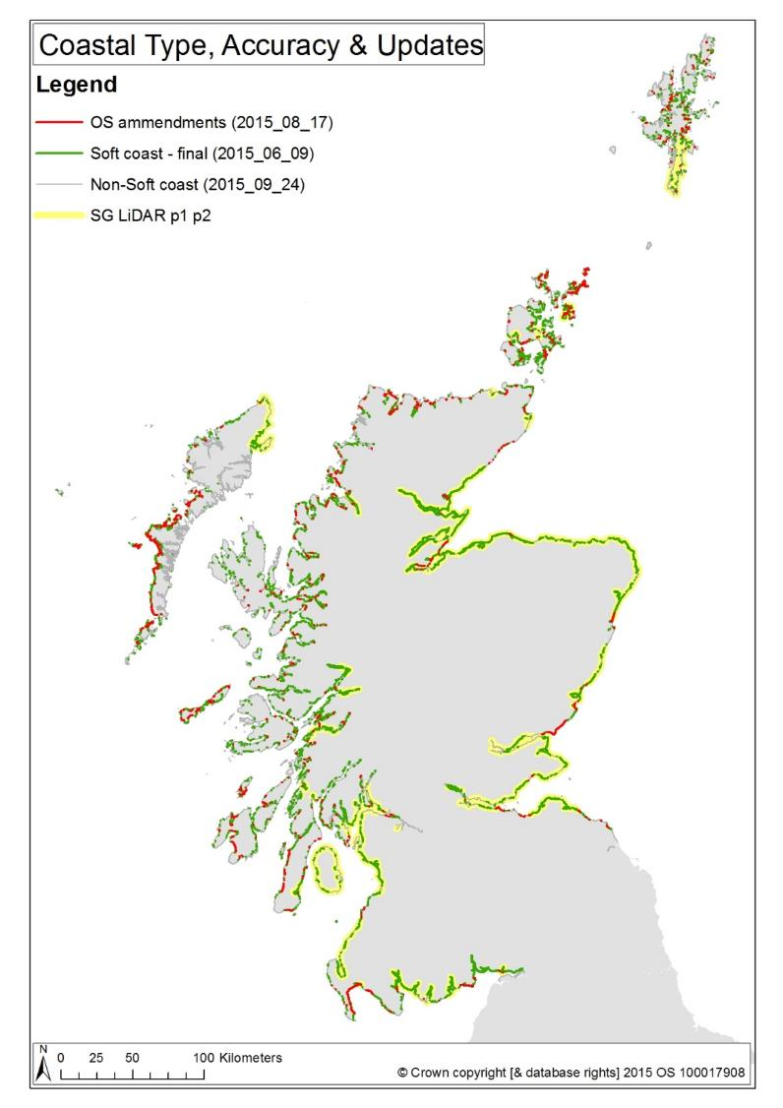
The NCCA has established (all measured on OS MasterMap):
Scotland’s coastline is 21,234 km long
4,434 km is soft / erodible
SG LiDAR covers 1,710 km of MHWS & will be used to update MHWS (Yellow area)
This leaves 2,724 km which was checked to ensure it’s accuracy
Of this 2,261 km (83%) was found to be representative (green line) and
463 km (17%) needed revision (red line)
The OS have updated MHWS for most of the areas requested by the end of Jan 2016.
Thereafter, these updated tidelines will be incorporated within OS products

Slide 19
Conclusions
The NCCA is a pan-government project which has classified Scotland’s erodible coast for the first time. The project is due to finish in September 2016.
It will inform statutory advice across Agencies and Local Authorities alike in support of their strategic planning individually, but also collaboratively, thereby supporting the SG Climate Change Adaptation Programme.
It will inform areas where erosion may influence flood risk – currently not identified within flood mapping.

Slide 20
Conclusions
It has led to the first checking & update of MHWS since the 1970s, and ensured that the OS can and will maintain this in the future. The NCCA has led to the OS considering revisions to their coastal mapping methods across the whole of the UK.

Slide 21
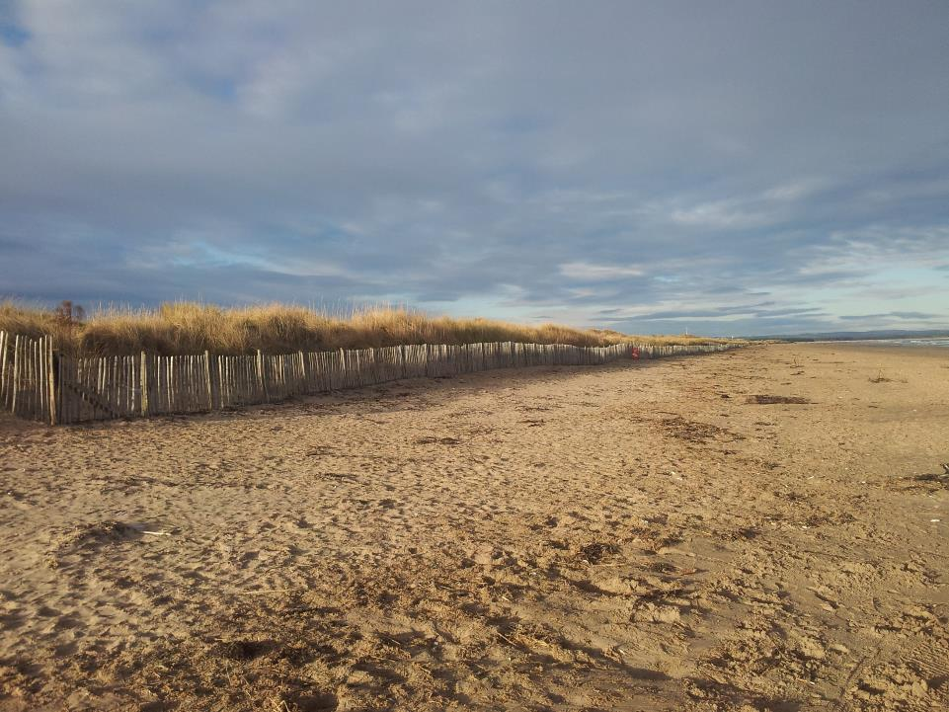
www.dynamiccoast.com
james.fitton@glasgow.ac.uk
@J_M_Fitton

