Slide 1
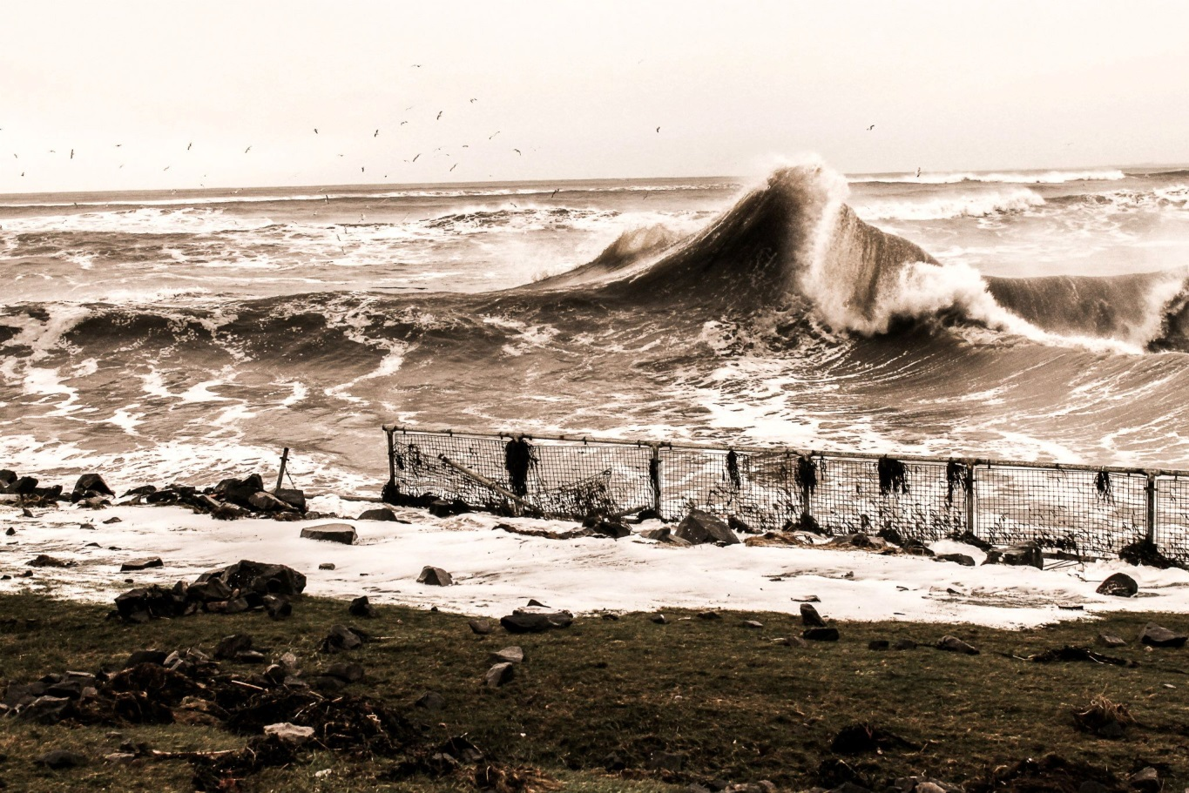
Scotland’s Future Coast:
The National Coastal Change Assessment
Alistair Rennie (SNH), James Fitton (UofG)
& Jim Hansom (UofG)

Slide 2
Presentation Outline
Introduction to Scottish Coast
Why is understanding coastal erosion important in Scotland?
What is the NCCA
Methods
Outputs

Slide 3
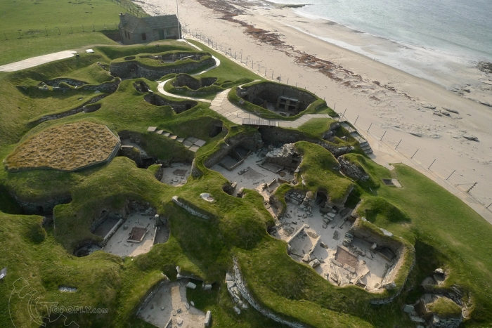
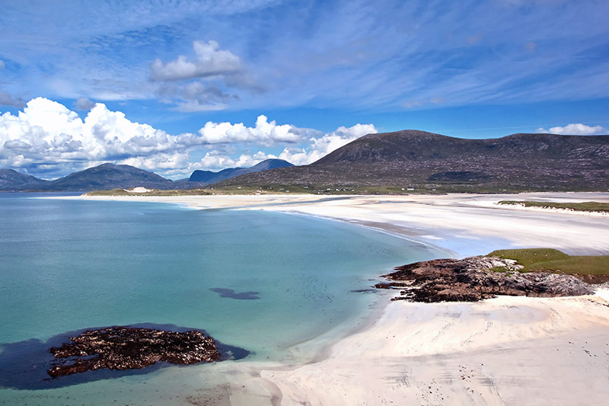
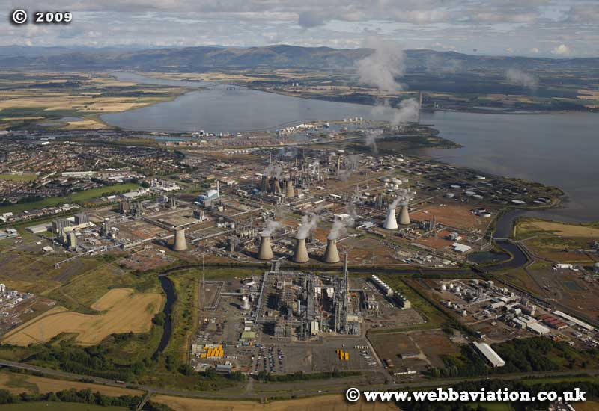
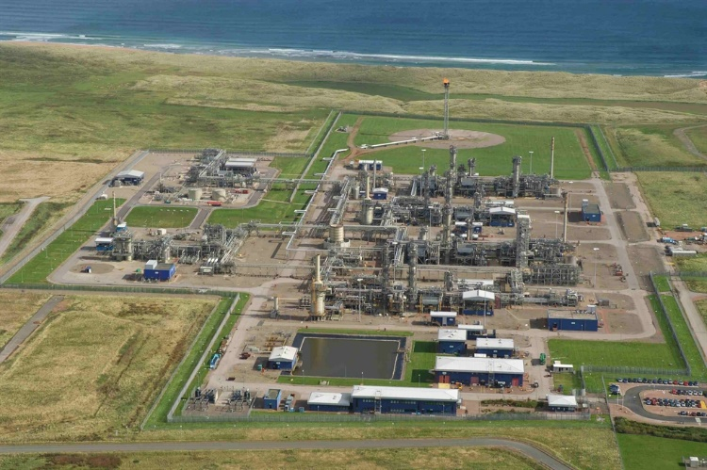
Scottish coastal assets
Population
20% of the Scottish population live within
1km of the coast (1 million people)
Scotland has 12% of the European coast (18,670 km)
Highly variable: resilience & assets

Slide 4
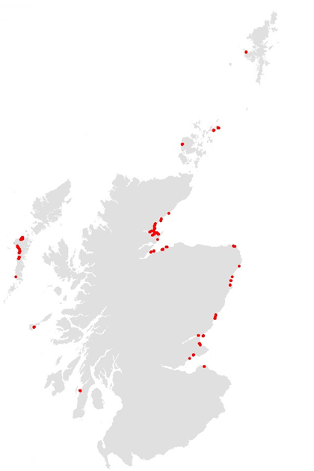
Coastal Erosion in Scotland
63 locations, 94 km
705 km of hard defences

Slide 5
National Coastal Change Assessment (NCCA)
A major policy-driven pan-government research project collating information on coastal change and susceptibility to future coastal erosion.
NCCA will:
Undertake a Quality Assessment on existing data
Establish the past changes to Scotland's coastline
Anticipate future change
Undertake an initial assessment of societies' interests within these areas (road, railways, houses etc)

Slide 6
Who is involved?
Scottish Government
Agencies
Local Authorities
Partners
The 50+ organisations are involved in the development of the project and will also have access to the maps.
Funded by CREW,
Scotland’s centre of expertise for waters

Slide 7
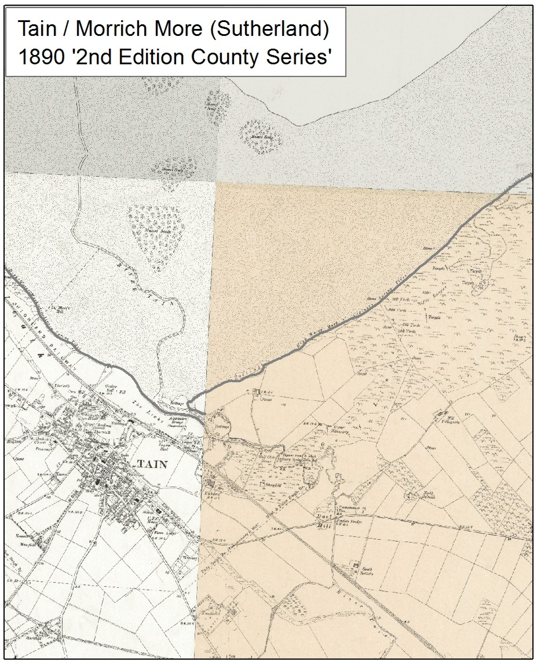
NCCA Methods
Historical change analysis is similar to SMPs
1890s
OS Second Edition Country Series Maps

Slide 8
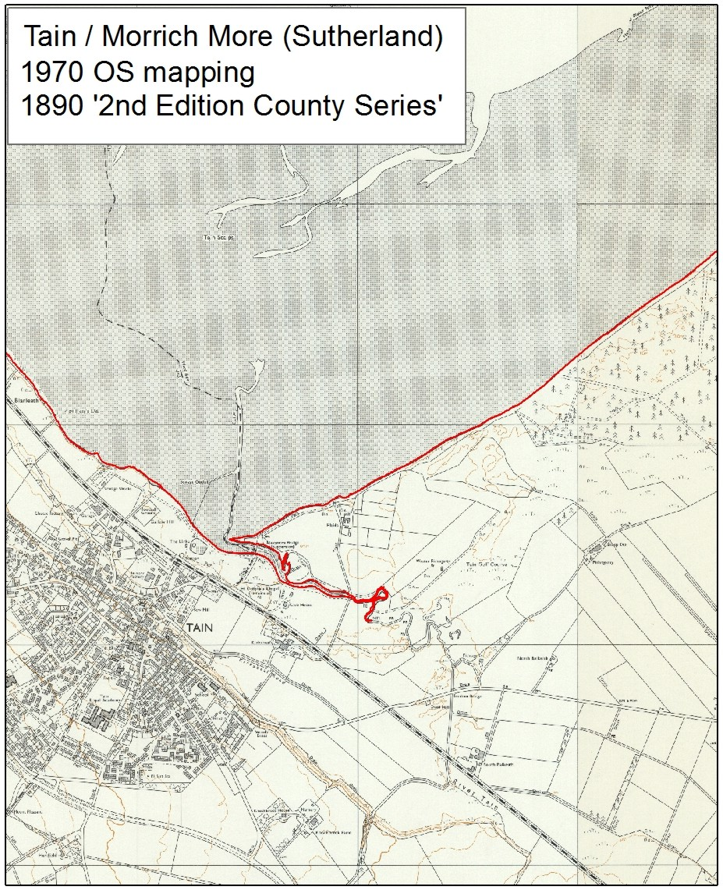
NCCA Methods
Historic Change Analysis
1890s
1970s

Slide 9
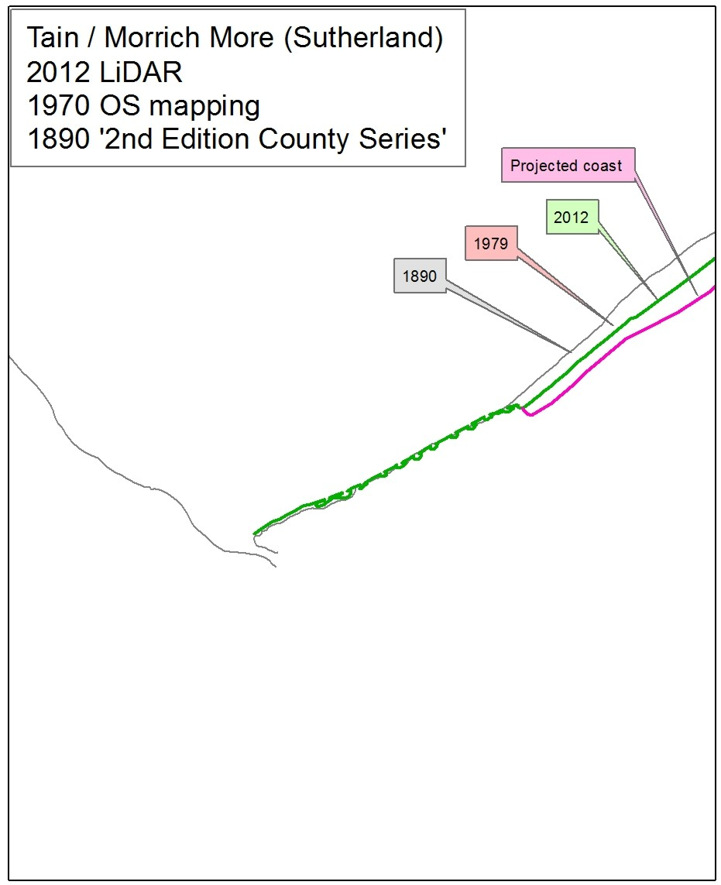
NCCA Methods
Historic Change Analysis
1890s
1970s
Current MHWS (derived from LiDAR/Aerial Photography)
Projected future coastline

Slide 10
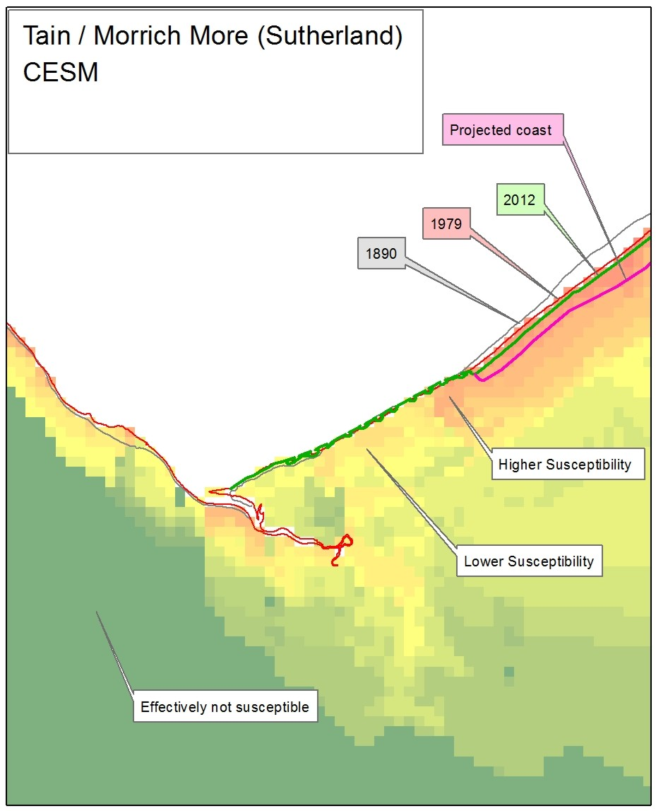
National Coastal Change Assessment (NCCA)
Historic Change Analysis
1890s
1970s
Current MHWS (derived from LiDAR/Aerial Photography)
Projected future coastline
- Amended by CESM

Slide 11
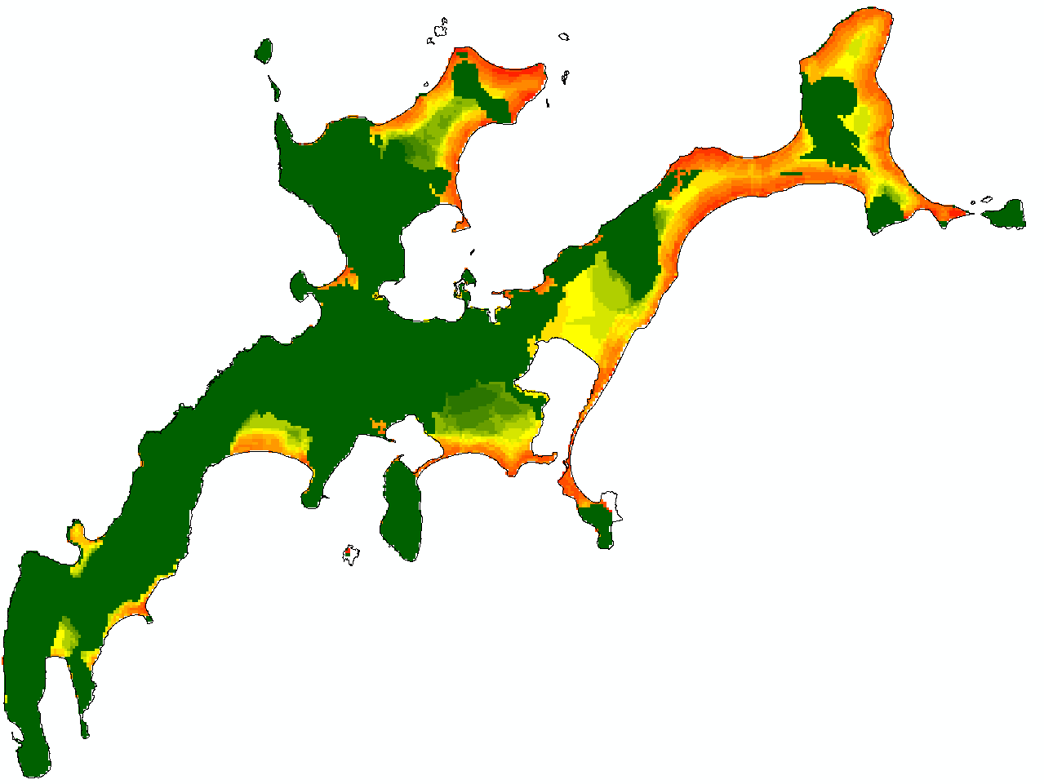
Coastal Erosion Susceptibility Model (CESM)
http://jmfitton.xyz/cesm_scotland/
High: 100
Low:0
5 km

Slide 12
Physical Parameter Ranking
Most
Susceptible
Least
Susceptible
 | 5 | 4 | 3 | 2 | 1
Elevation (mAOD) | < 2 | 2 – 4 | 4 – 6 | 6 – 8 | > 8
Rockhead (mAOD) | < 0 | 0 - 2 | 2 - 4 | 4 – 6 | > 6
Proximity to Open Coast (m) | < 100 | 100 – 200 | 200 – 300 | 300 – 400 | >400
Wave Exposure | >300 | 225 - 300 | 150 - 225 | 75 - 150 | <75
Coastal defences and accretion also incorporated
All in national 50 m² raster
Wave exposure weighted 0.5

Slide 13
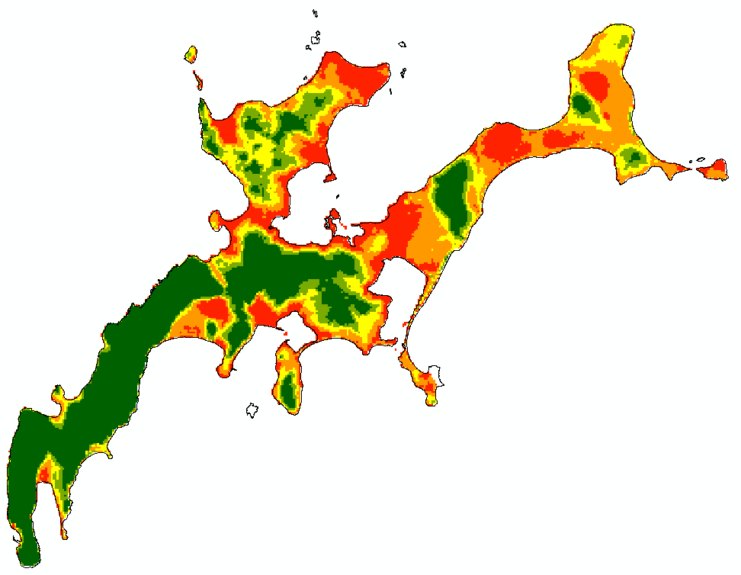
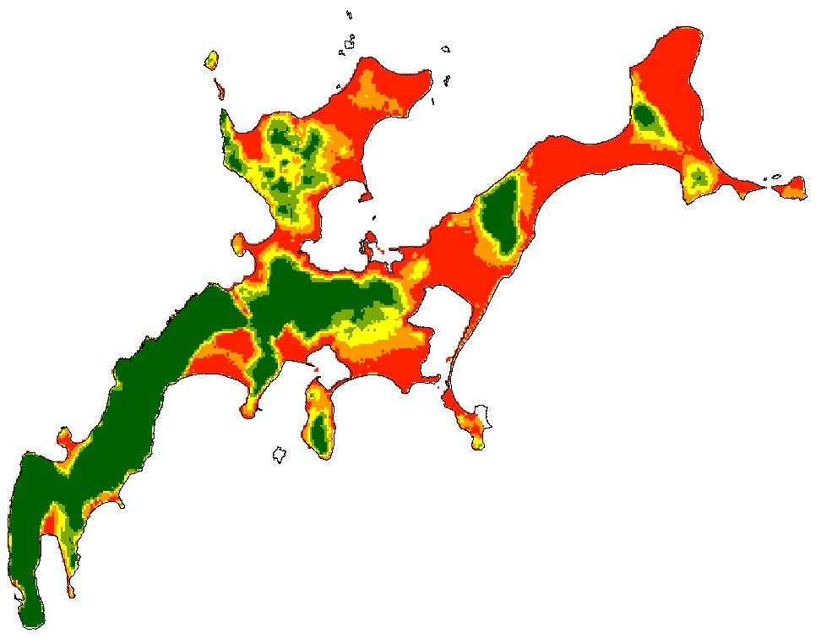
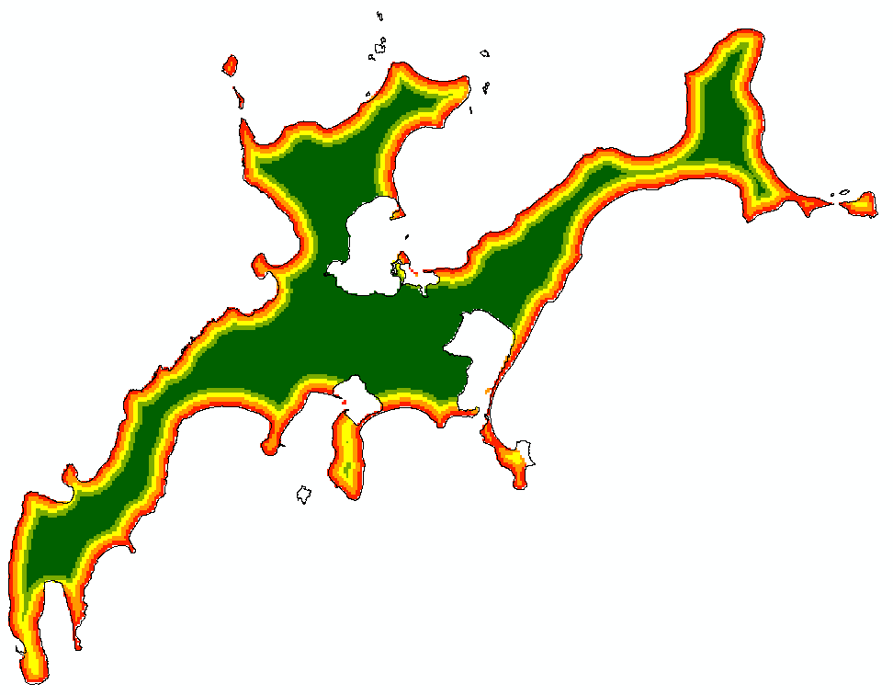
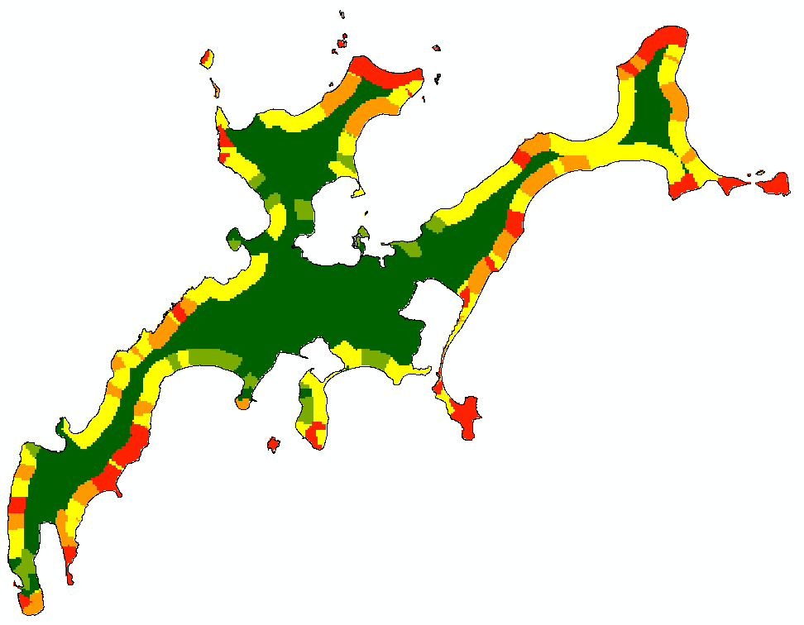
Elevation
Rockhead
Proximity to Open Coast
Max Score of 17.5 (5 + 5 + 5 + 2.5)
Min Score of 3.5 (1 + 1 +1 + 0.5)
Wave Exposure

Slide 14
Planned Outputs
Mapping datasets, reports
workshops
Anticipated to include:
Past and future coastal positions
Susceptible assets
Coastal Erosion Policy Review
Enable strategic planning
We’ve looked at the evidence base, but are our policies appropriate now and for the future?

Slide 15
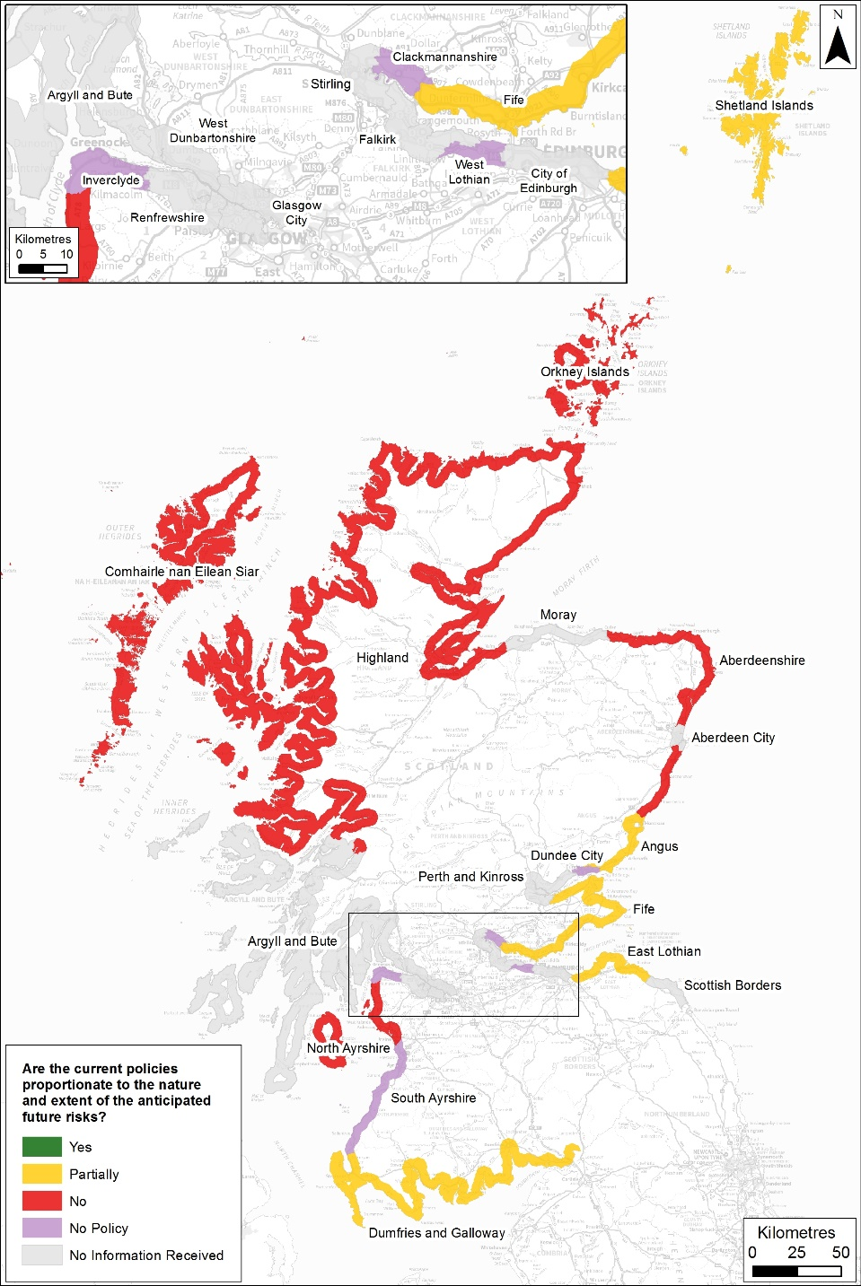
Policy Review – are our policies aware of CE?
No
No
Partial
Current
Future
Partial
Yes

Slide 16
Additional Outputs
Mapping of Current Coastline Position
Assumption that coastline was adequately mapped.
Do we know where the coastline is?

Slide 17
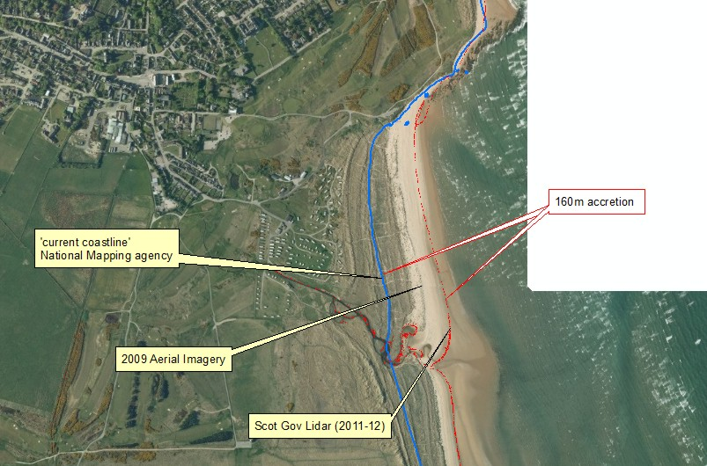

Slide 18
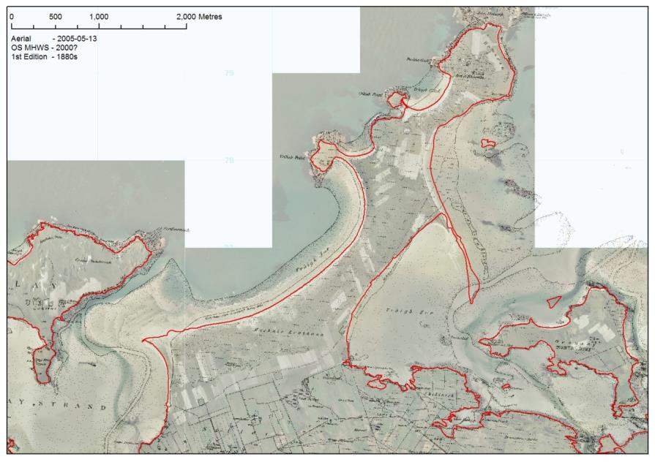
Udal peninsula (N Uist)
450m in 125yrs = 3.6m/yr

Slide 19
Additional Outputs
Mapping of Current Coastline Position
Assumption that coastline was adequately mapped.
Do we know where the coastline is?
‘Soft’ and ‘Hard’ Coastal Classification
Target future shoreline mapping in priority areas
Undertake future assessments in priority areas

Slide 20
Conclusions
NCCA will
establish a national evidence base on the past changes to Scotland's coastline, anticipate future change and produce an initial exposure assessment of assets within these areas (road, railways, houses etc)
it will support the public and private sector with better information to enable improved strategic management of the coastline and societies interests

Slide 21
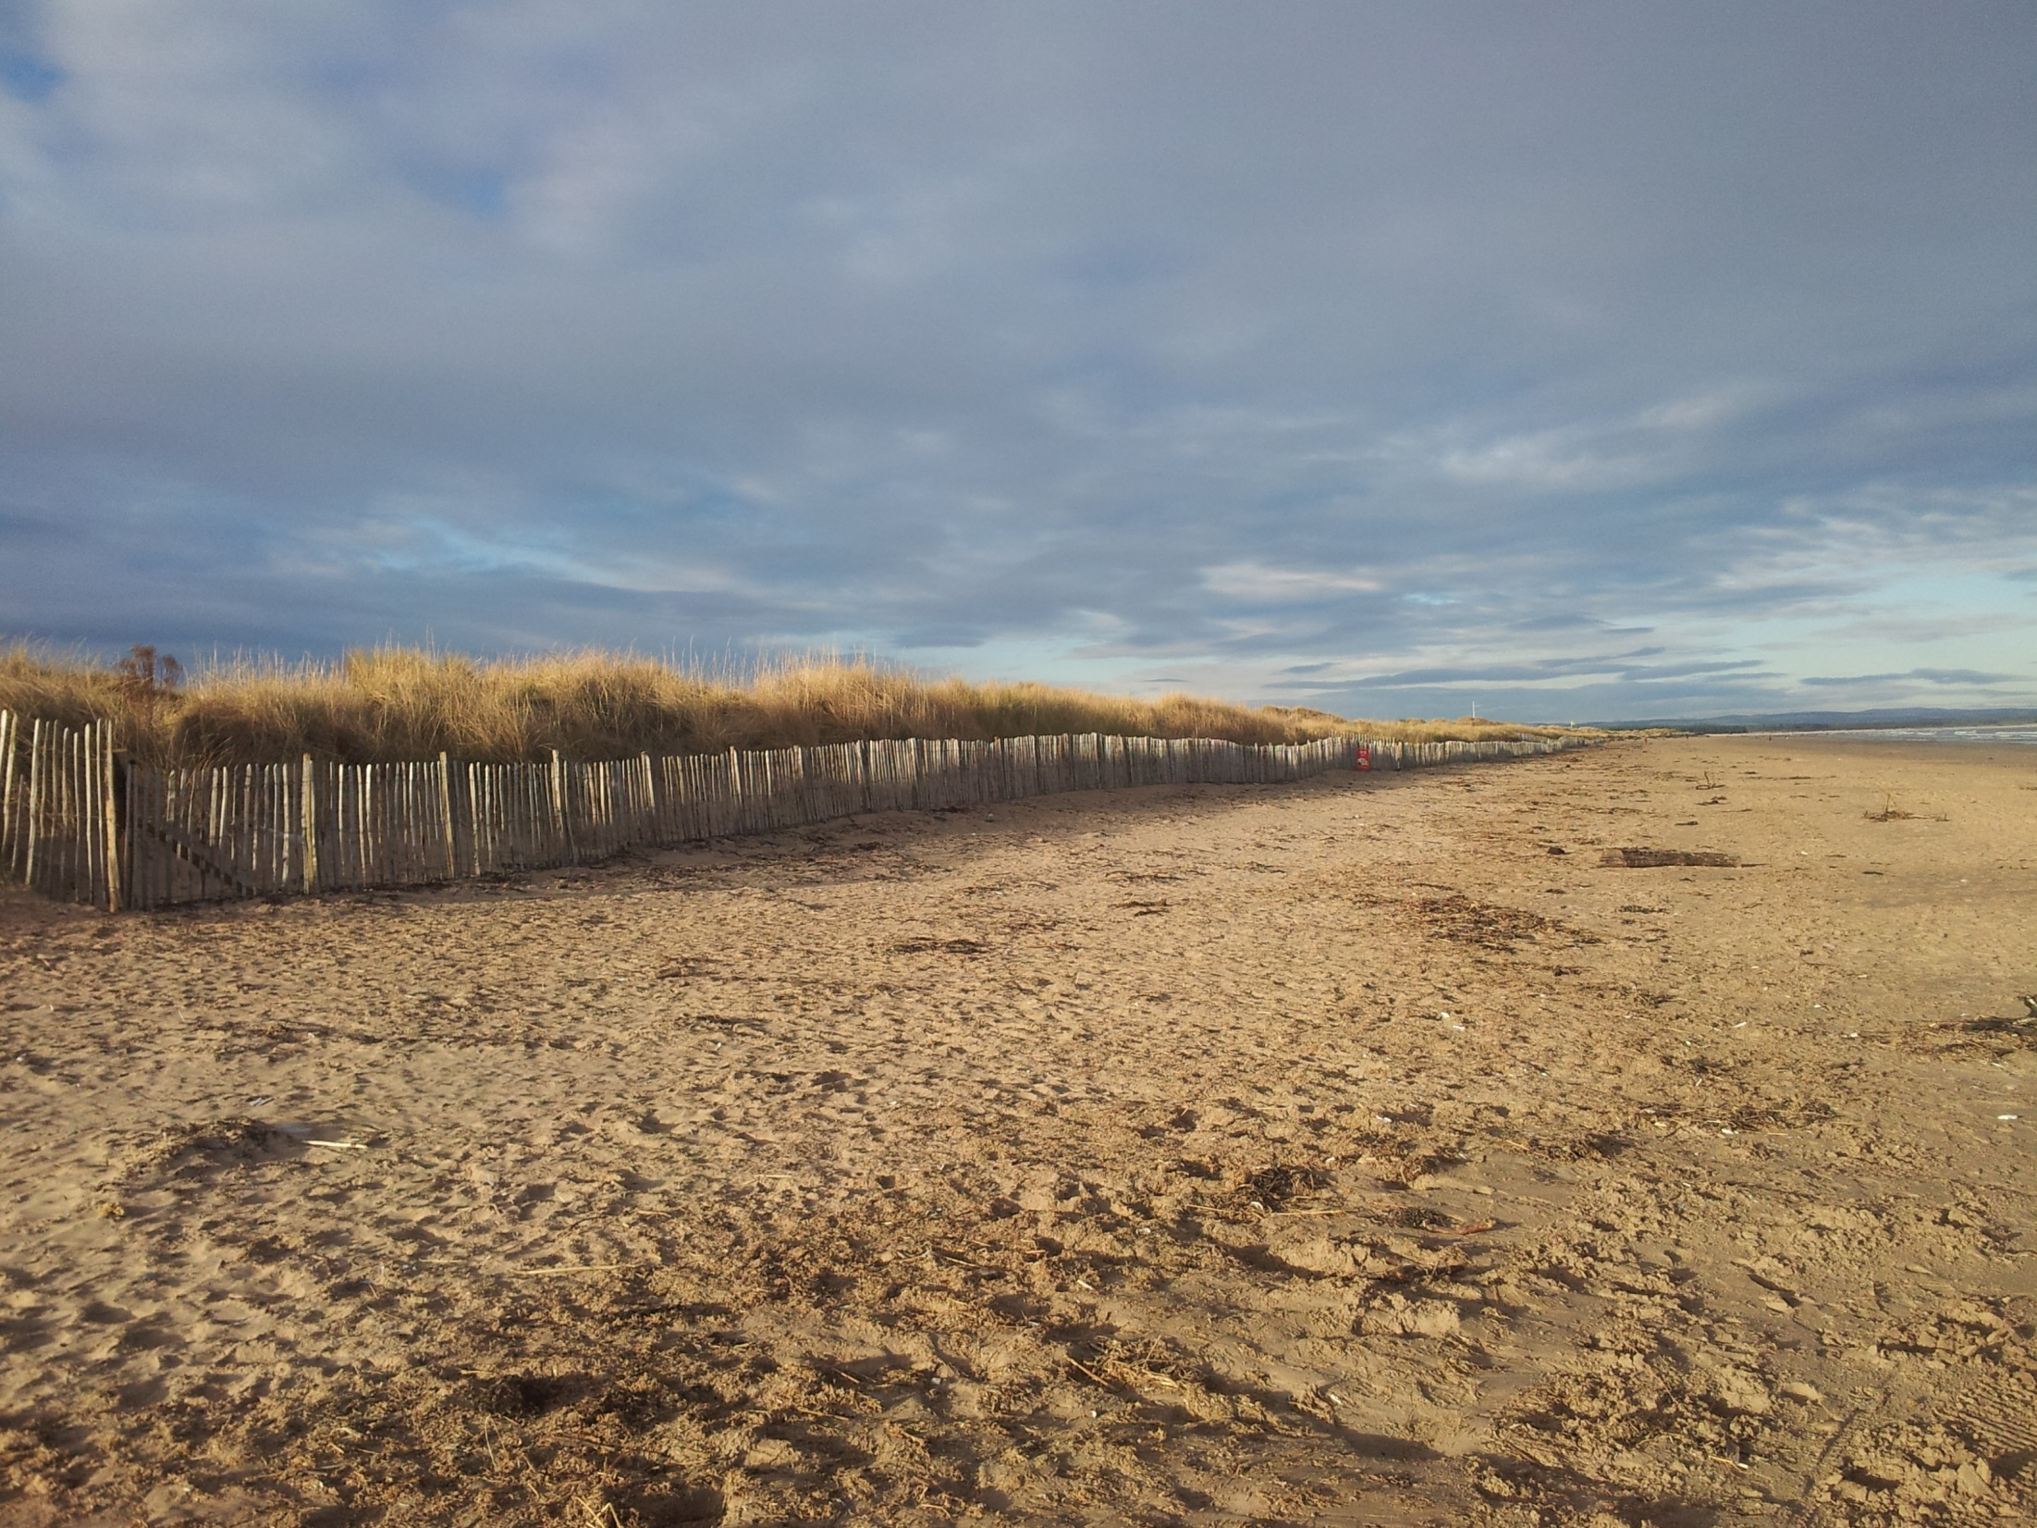
alistair.rennie@snh.gov.uk
j.fitton.1@research.gla.ac.uk
jim.hansom@glasgow.ac.uk
@RennieAlistair
@J_M_Fitton
http://jmfitton.xyz/cesm_scotland/

