Slide 1
Dynamic Coast Summary results from phase 1 (2017)
The following images are made available for re-use. Should you need to reference the source report:
Hansom, J.D., Fitton, J.M., and Rennie, A.F. (2017) Dynamic Coast - National Coastal Change Assessment: National Overview, CRW2014/2.

Slide 2
Figure 2.1: Proportion of Hard & Mixed (78% - 15,613 km), Soft (19% - 3,802 km) and Artificial (3% - 591 km) coastline in Scotland (Source: NCCA).

Slide 3
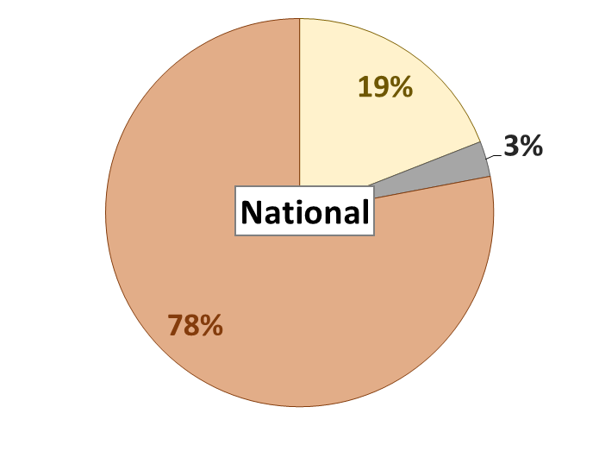
Proportion of Hard & Mixed (78% - 15,613 km), Soft (19% - 3,802 km) and Artificial (3% - 591 km) coastline in Scotland (Source: NCCA).

Slide 4
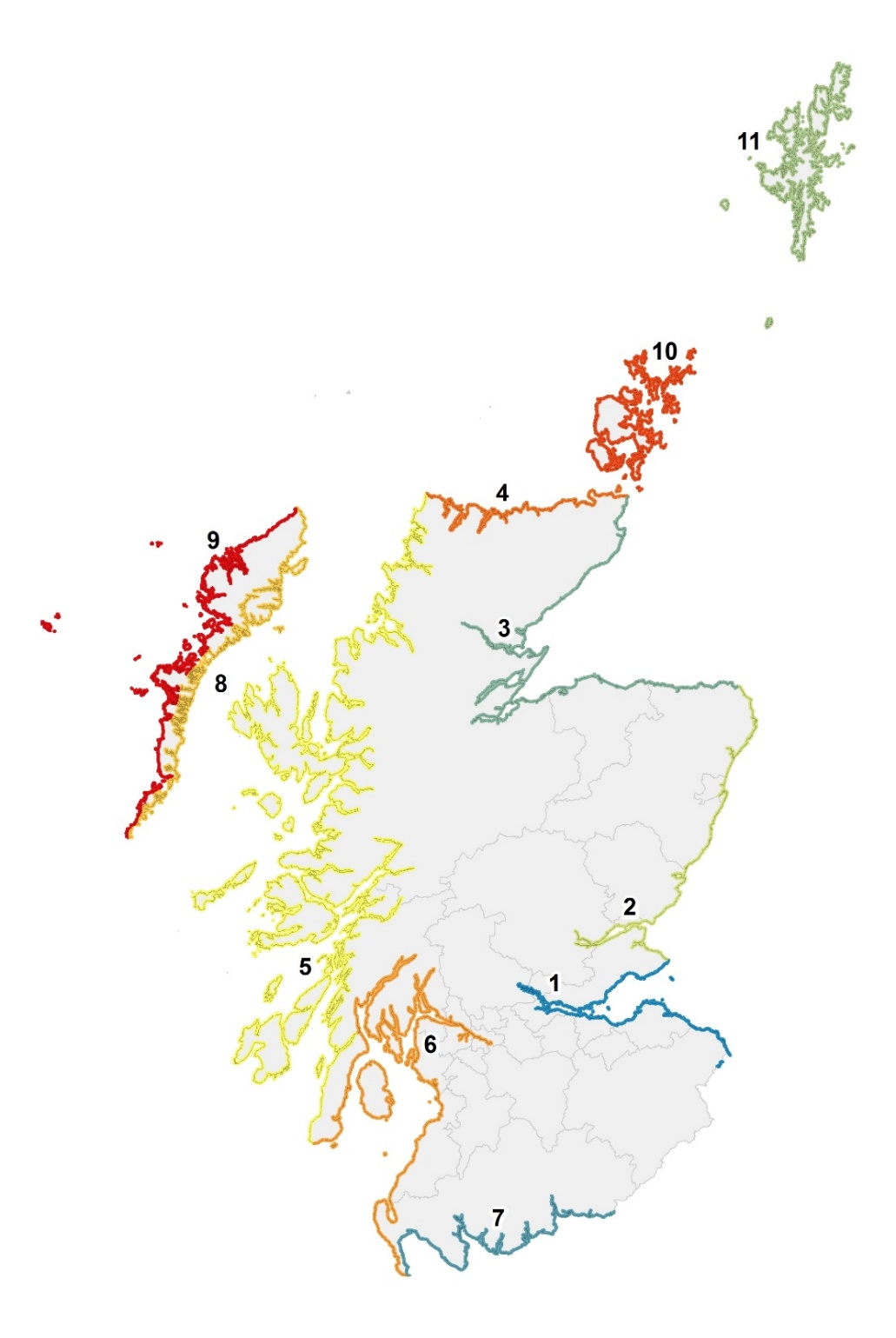
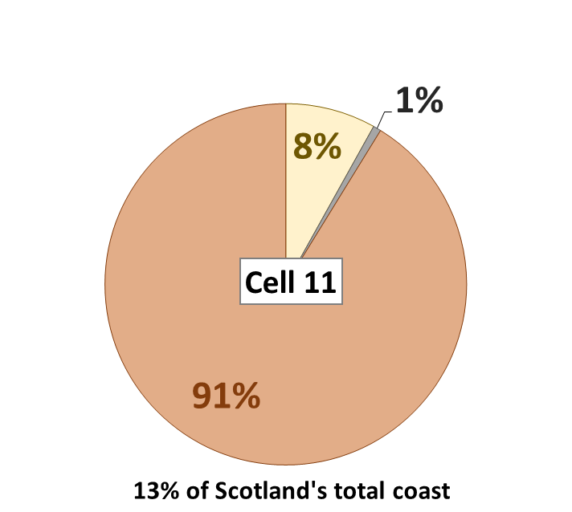
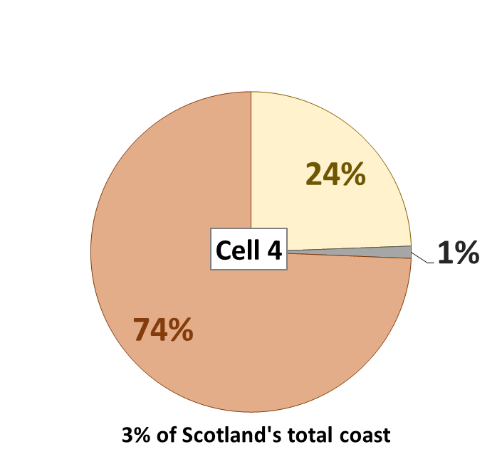
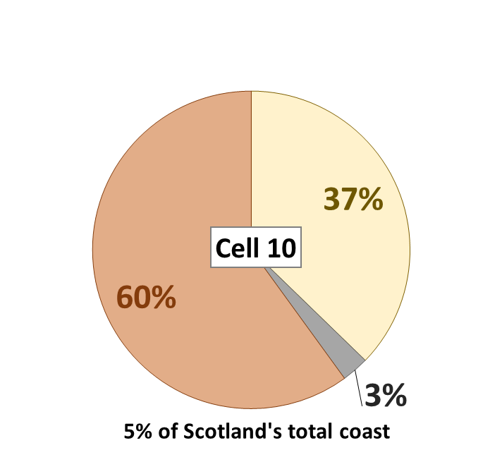
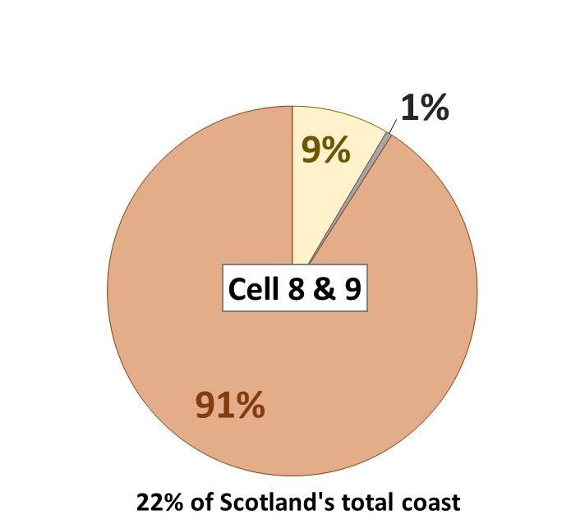
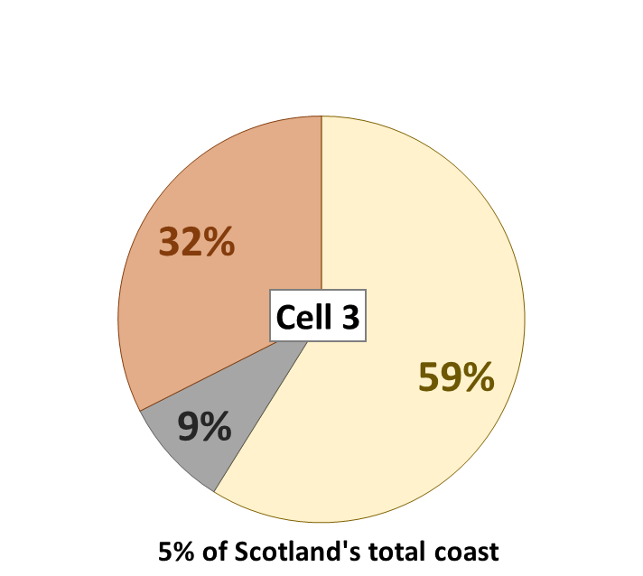
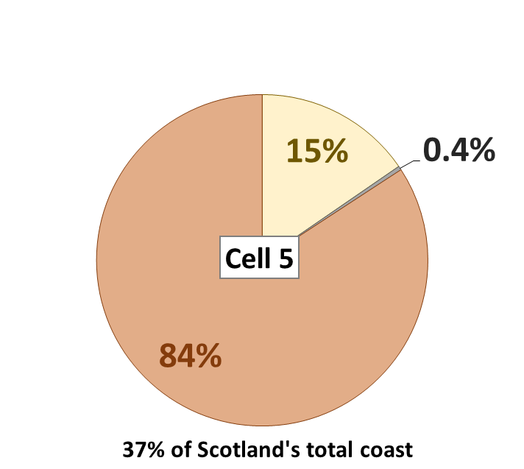
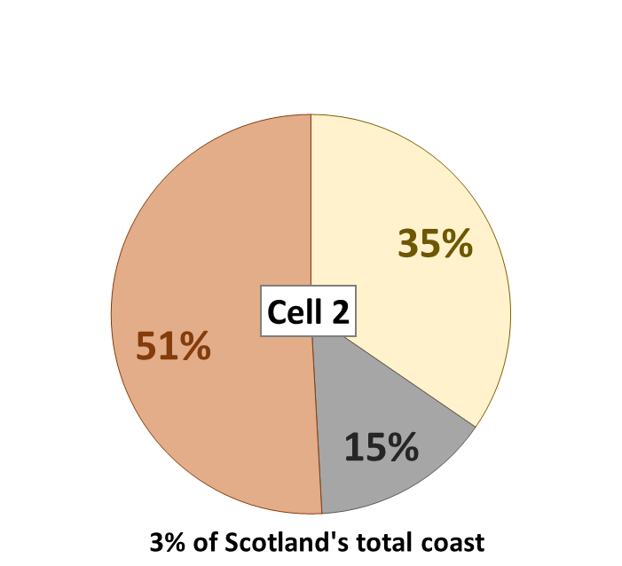
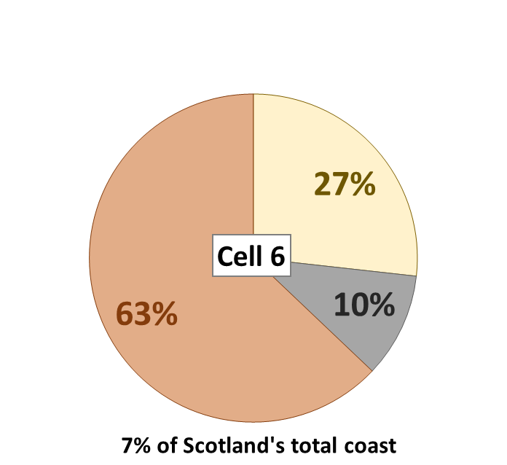
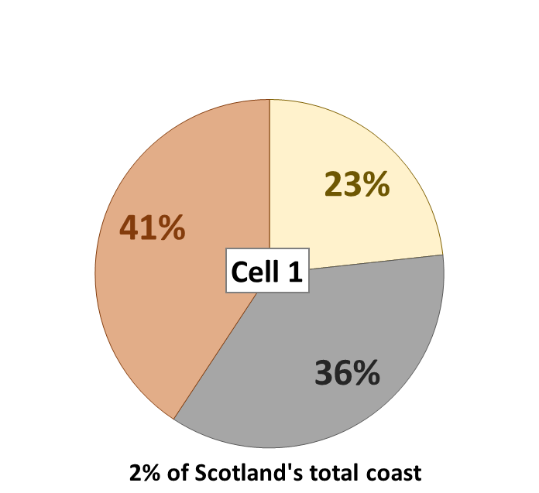
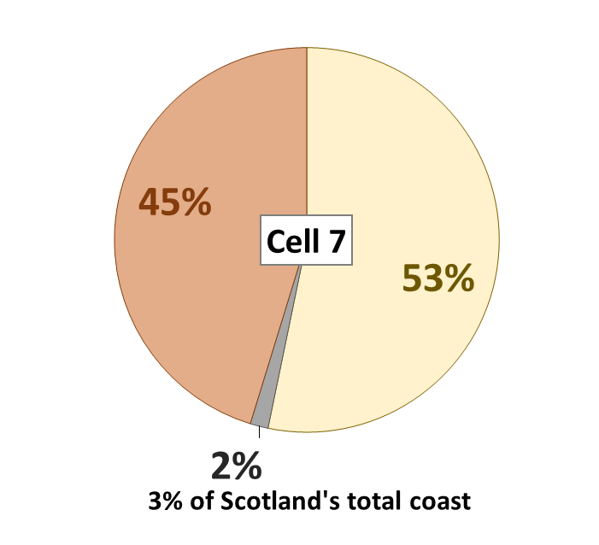
Figure 2.2: Distribution of Hard & Mixed, Soft and Artificial coastlines in Scotland, by coastal cell (Source: NCCA).

Slide 5
Figure 2.3 Historical coastal change results (not adjusted for time period)
Has the soft coast changed position since the 1970s?

Slide 6
Figure 2.4: The proportion of soft coast that has advanced, retreated, or not changed in the historical (1890-1970) and modern (1970-Modern) time periods (historical data normalised to 37yrs).
Coastal Type
1890 - 1970
1970 - Modern

Slide 7
Figure 2.3 Historical coastal change results (1890 – 1970 not adjusted for time period)

Slide 8
The proportion of soft coast that has advanced, retreated, or not changed in the modern (1970-Modern) time period.

Slide 9
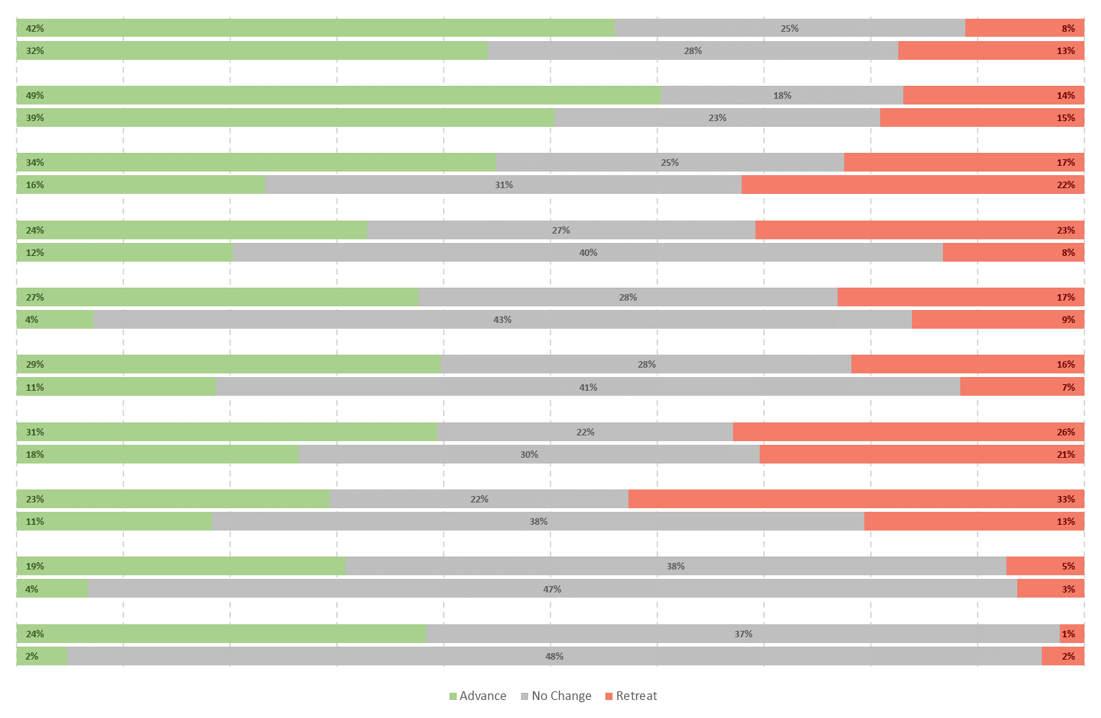
The proportion of soft coasts within each coastal cell that has advanced, retreated, or not changed in the historical (1890-1970) and modern (1970-Modern) time periods (historical data normalised to 37yrs).
Cell 1
1890 - 1970
1970 - Modern
Cell 2
1890 - 1970
1970 - Modern
Cell 3
1890 - 1970
1970 - Modern
Cell 4
1890 - 1970
1970 - Modern
Cell 5
1890 - 1970
1970 - Modern
Cell 6
1890 - 1970
1970 - Modern
Cell 7
1890 - 1970
1970 - Modern
Cells 8 & 9
1890 - 1970
1970 - Modern
Cell 10
1890 - 1970
1970 - Modern
Cell 11
1890 - 1970
1970 - Modern

Slide 10
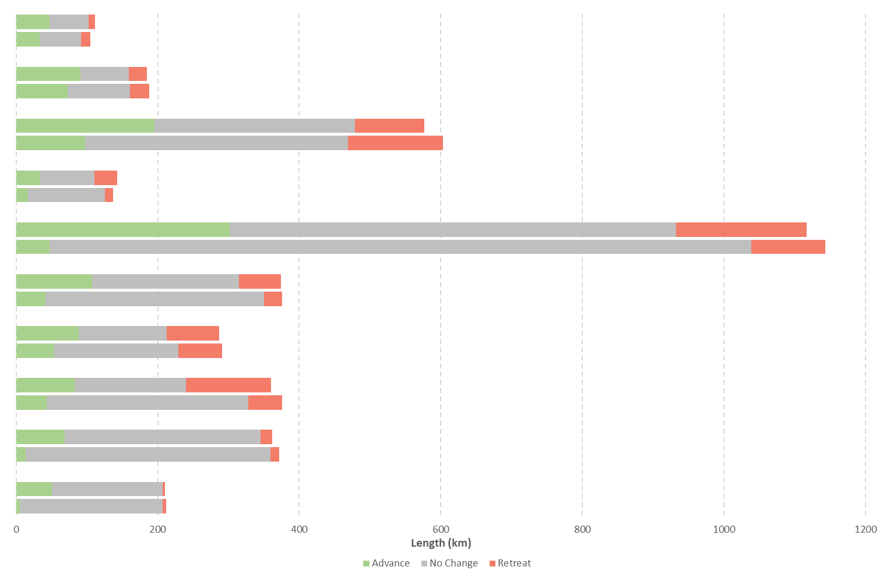
The proportion of soft coasts within each coastal cell that has advanced, retreated, or not changed in the historical (1890-1970) and modern (1970-Modern) time periods (historical data normalised to 37yrs).
Cell 1
1890 - 1970
1970 - Modern
Cell 2
1890 - 1970
1970 - Modern
Cell 3
1890 - 1970
1970 - Modern
Cell 4
1890 - 1970
1970 - Modern
Cell 5
1890 - 1970
1970 - Modern
Cell 6
1890 - 1970
1970 - Modern
Cell 7
1890 - 1970
1970 - Modern
Cells 8 & 9
1890 - 1970
1970 - Modern
Cell 10
1890 - 1970
1970 - Modern
Cell 11
1890 - 1970
1970 - Modern

Slide 11
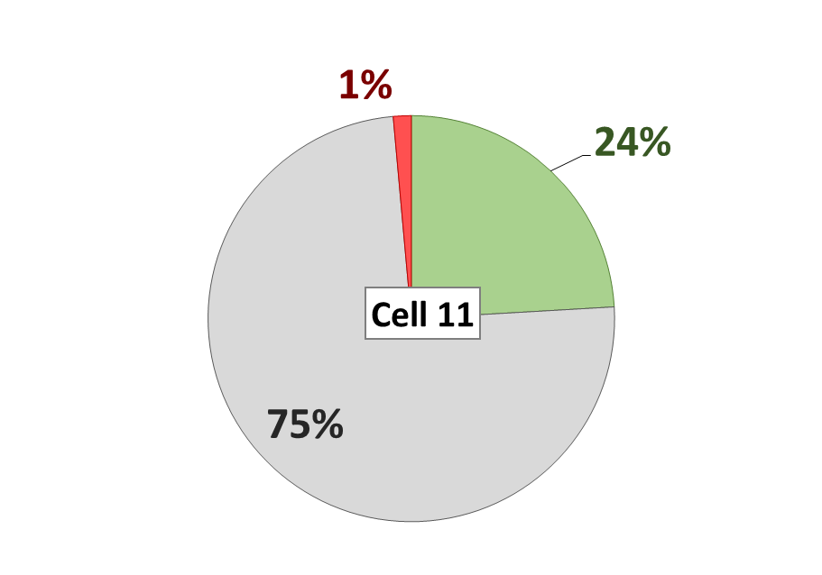
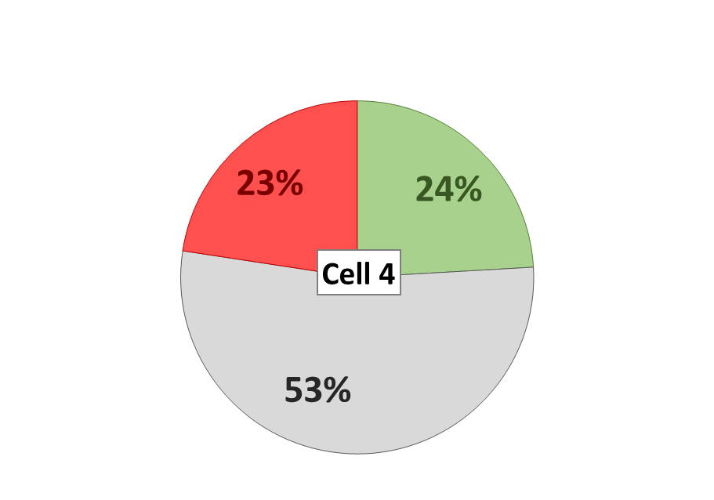
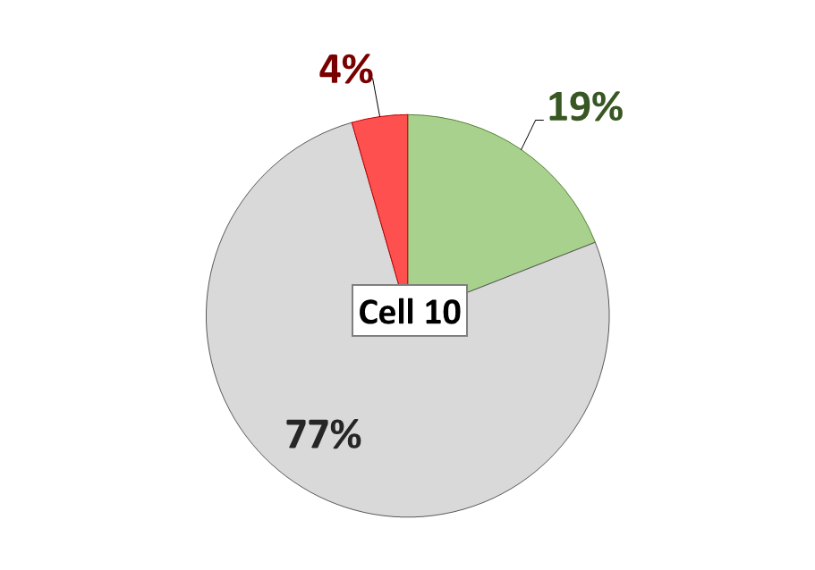
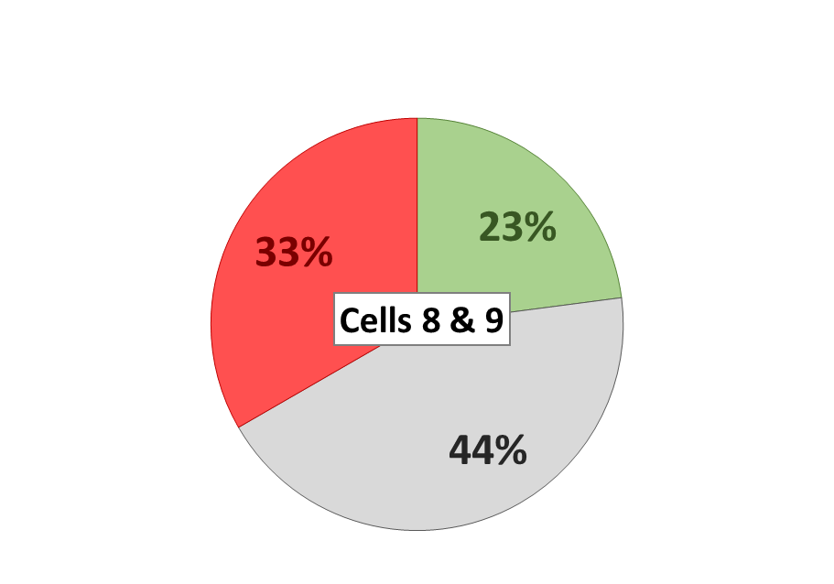
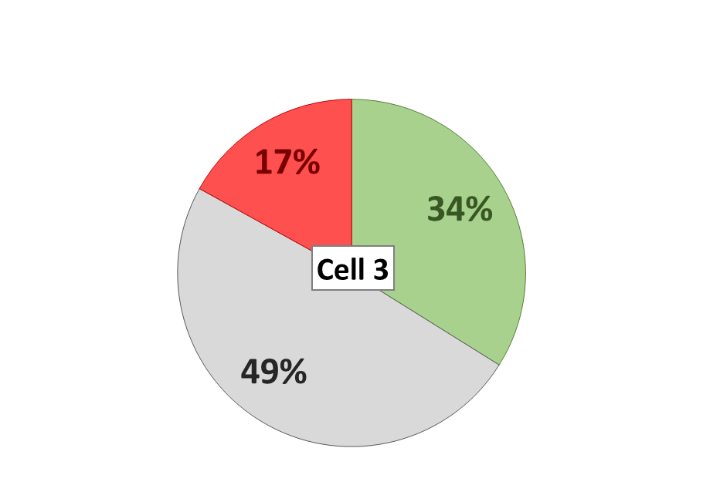
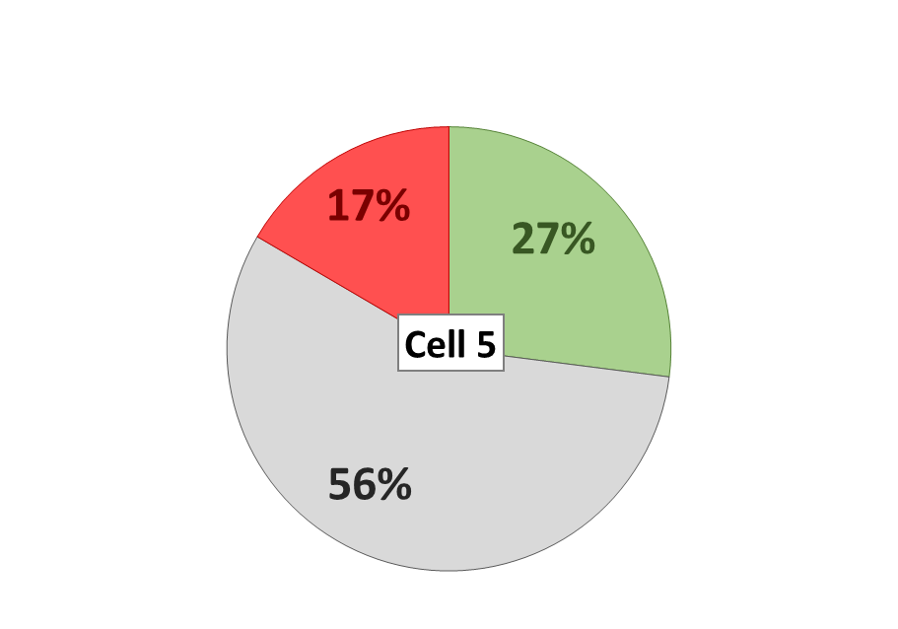
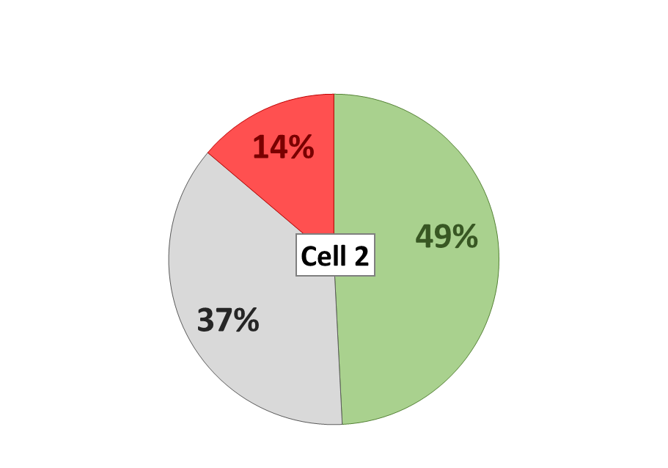
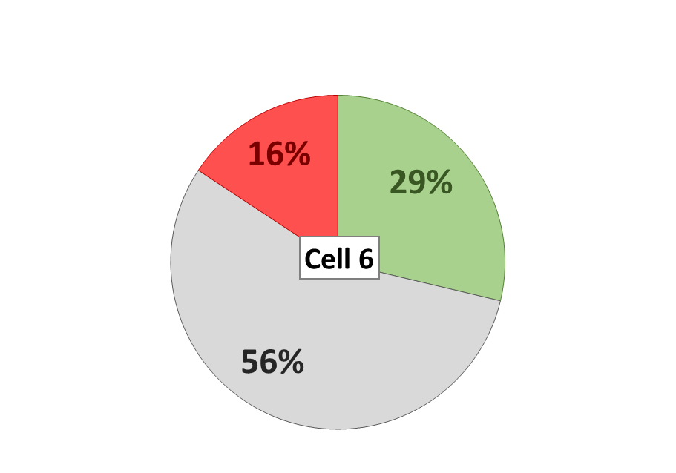
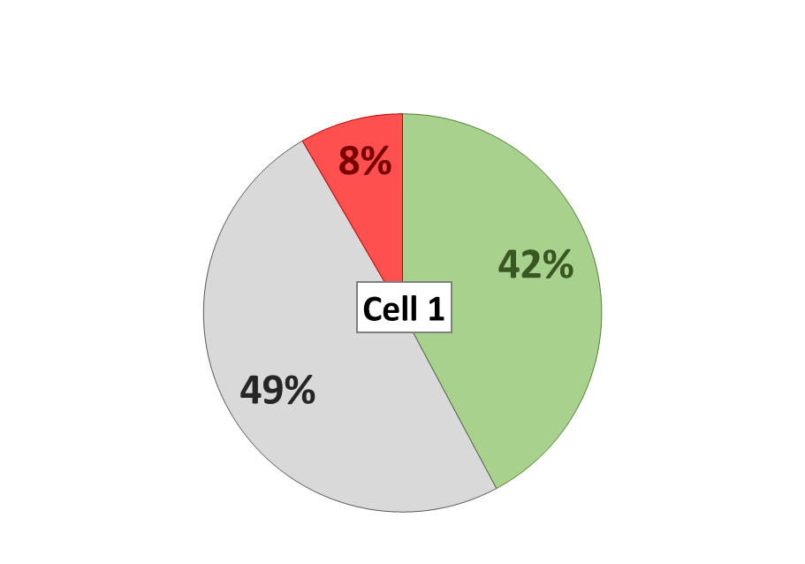
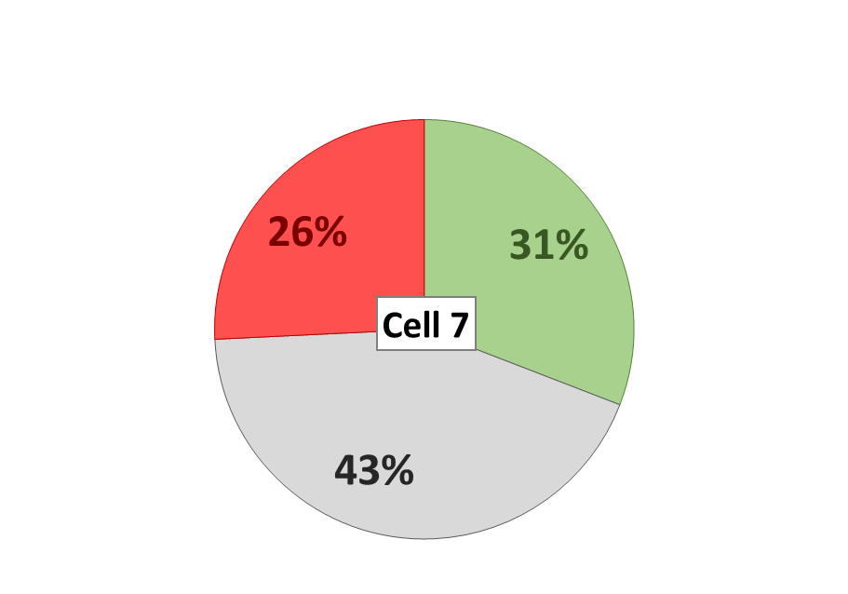
The proportion of advance, retreat and no change along the soft coast within the 1890-1970 data within each coastal cell. Note the larger proportion of accretion and erosion within the east coast cells and Solway Firth (Cells 1-3 & 7).

Slide 12
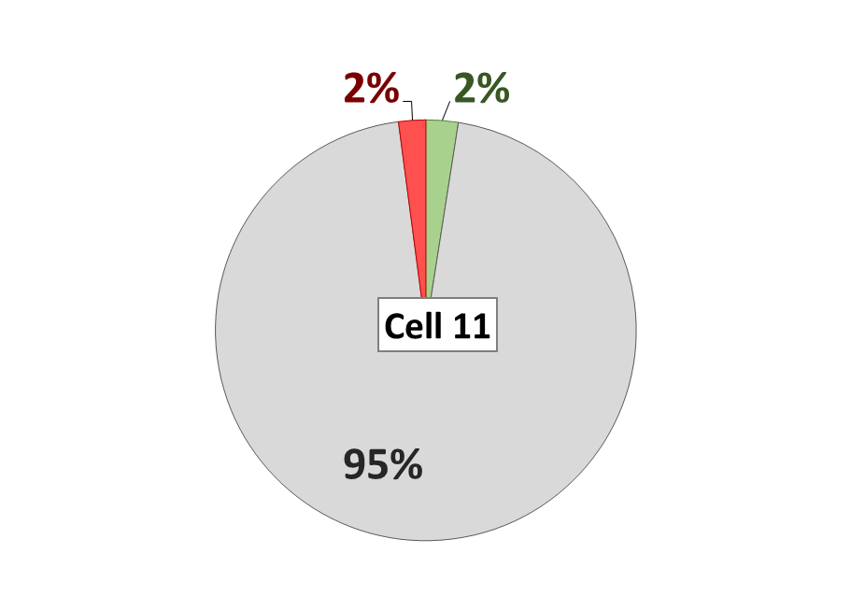
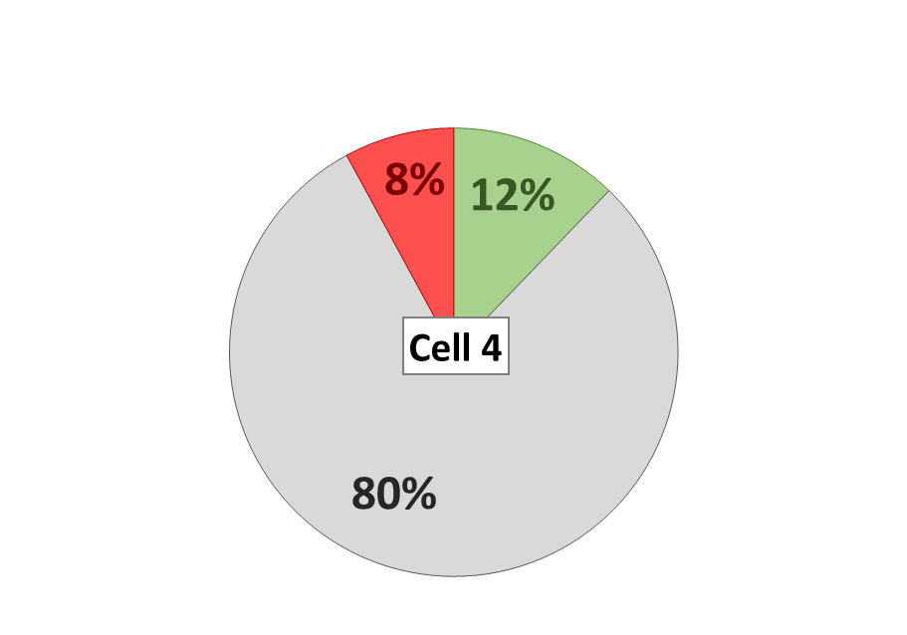
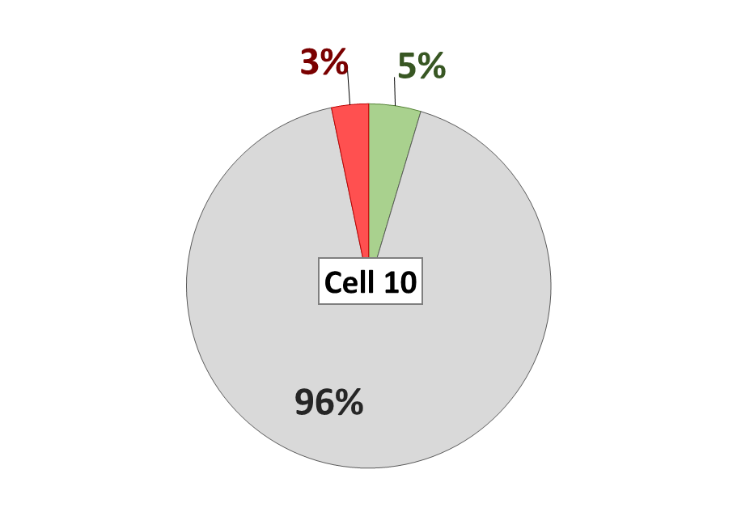
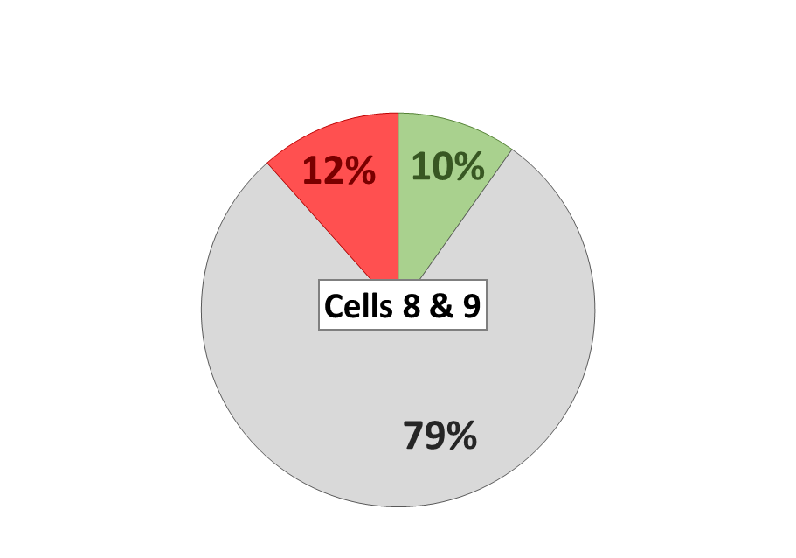
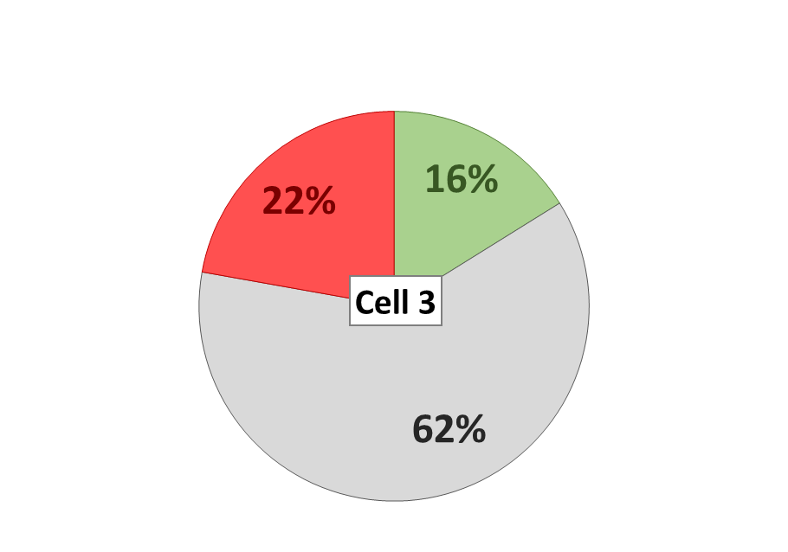
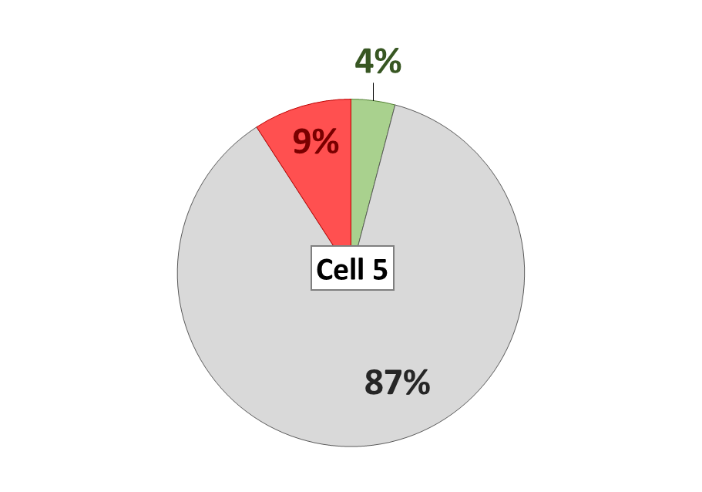
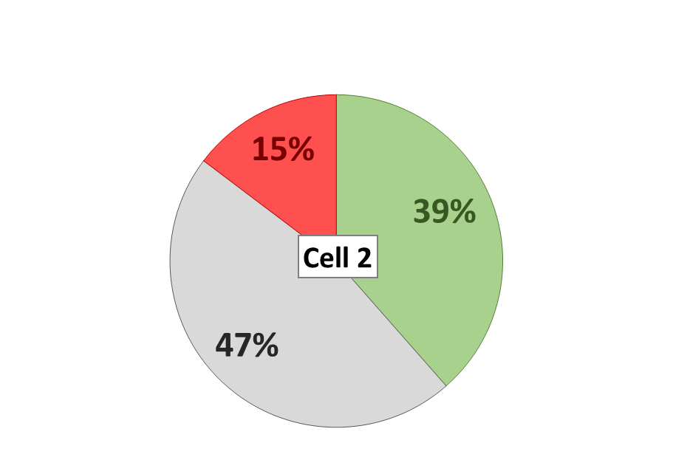
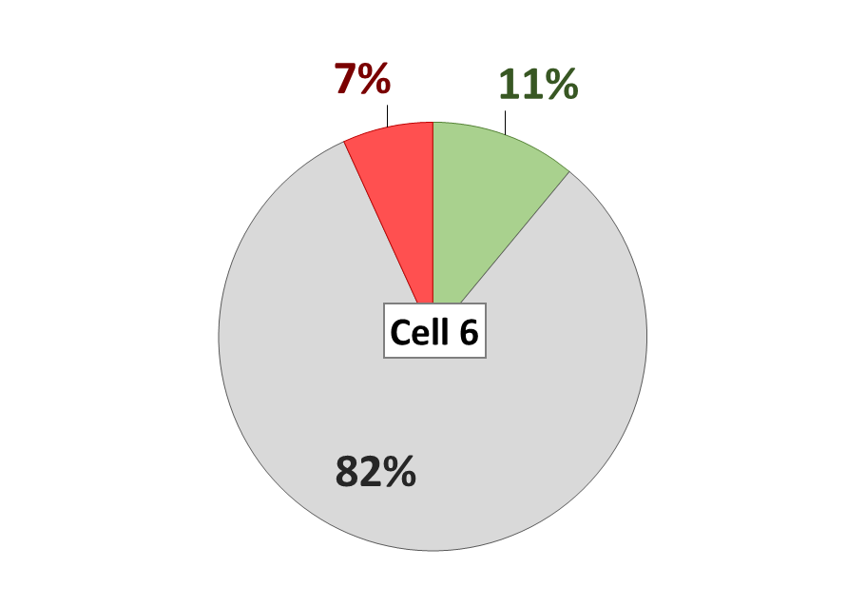
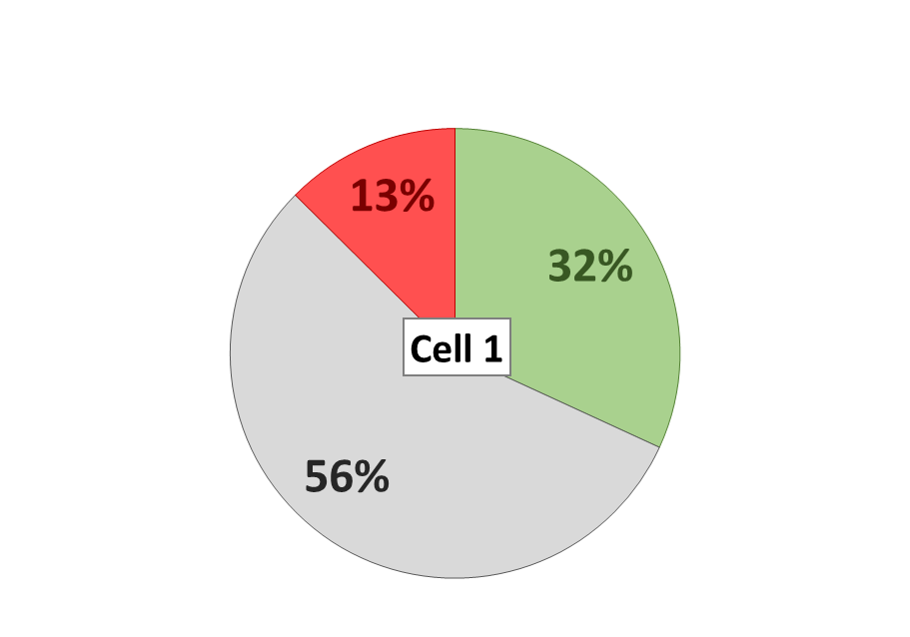
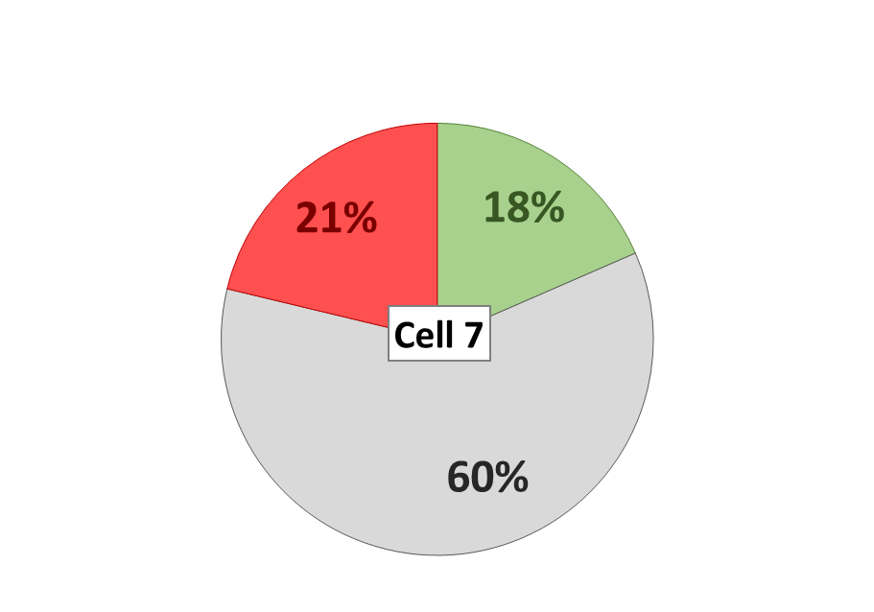
Figure 2.6: The proportion of advance, retreat and no change along the soft coast within the 1970-Modern data within each
coastal cell. Note the larger proportion of accretion and erosion within the east coast cells and Solway Firth (Cells 1-3 & 7).

